Slide 1
ECEG-5193: Algorithm Analysis and Design
Algorithms of Graph Problems
Connected Components

Slide 2
Connected Components

Slide 5
Connected Components
Let G = (V, E) be an undirected graph.
Two nodes u, v ∈ V are called connected iff there is a path from u to v.
A connected component of G is a set C ⊆ V
with the following properties:
C is nonempty.
For any u, v ∈ C: u and v are connected.
For any u ∈ C, v ∈ V – C: u and v are not connected.

Slide 6
Properties of Connected Components
All of the following are true:
Any two connected components C₁ and C₂ are either equal or disjoint.
Every node in a graph belongs to exactly one connected component.
The connected components of a graph form a partition of the nodes of the graph.
Notes:
it's an interesting exercise to prove them

Slide 7
Finding Connected Components
Run DFS …

Slide 9
procedure findCCs(graph G):
for each node v: color v gray
let cc be an array of size n
let index = 0
for each node in v:
if v is gray:
run DFS(v), setting cc[u] = index
whenever a node u is colored green index = index + 1
return cc

Slide 13
0

Slide 14
0
0

Slide 15
0
0
0

Slide 16
0
0
0
0

Slide 17
0
0
0
0
0

Slide 18
0
0
0
0
0

Slide 19
0
0
0
0
0

Slide 20
0
0
0
0
0

Slide 21
0
0
0
0
0

Slide 22
0
0
0
0
0

Slide 23
0
0
0
0
0

Slide 24
0
0
0
0
0

Slide 25
0
0
0
0
0

Slide 26
0
0
0
0
0

Slide 27
0
0
0
0
0

Slide 28
0
0
0
0
0

Slide 29
0
0
0
0
0

Slide 30
0
0
0
0
0

Slide 31
0
0
0
0
0

Slide 32
0
0
1
0
0
0

Slide 33
0 | 0 | 1
0 | 0 | 1
 | 0

Slide 34
0 | 0 | 1
0 | 0 | 1
 | 0 | 1

Slide 35
0
0
1
1
0
0
1
0
1

Slide 36
0
0
1
1
0
0
1
0
1

Slide 37
0
0
1
1
0
0
1
0
1

Slide 38
0
0
1
1
0
0
1
0
1

Slide 39
0
0
1
1
0
0
1
0
1

Slide 40
0
0
1
1
0
0
1
0
1

Slide 41
0
0
1
1
0
0
1
0
1

Slide 42
0
0
1
1
0
0
1
0
1

Slide 43
0
0
1
1
0
0
1
0
1

Slide 44
0
0
1
1
0
0
1
0
1

Slide 45
0
0
1
1
0
0
1
0
1

Slide 46
0
0
1
1
0
0
1
0
1

Slide 47
0
0
1
1
0
0
1
0
1

Slide 48
0
0
1
1
0
0
1
0
1

Slide 49
0
0
1
1
0
0
1
0
1

Slide 50
0 | 0 | 1 | 1
0 | 0 | 1 | 2
 | 0 | 1 | 2

Slide 51
Analyzing the Runtime
We do Θ(n) work initially coloring each node gray.
Across all iterations of DFS, each node is visited exactly once and each edge is visited exactly once. This takes Θ(m + n) time.
Consequently, total work is Θ(m + n).
Could we also use BFS here? If so, what would the runtime be?

Slide 52
Strongly Connected Components

Slide 53
Strongly connected
Given a directed graph, can we reach any node v from any other node u?
Ideas?

Slide 54
Directed Connectivity
In a directed graph G, we say v is reachable from u iff there is a path from u to v.
In an undirected graph, if there is a path from u to v, there is also a path from v to u.
How would we generalize the idea of a connected component to a directed graph?
Notes:
In a directed graph, it is possible for there v to be reachable from u, but for u not to be reachable from v.

Slide 55
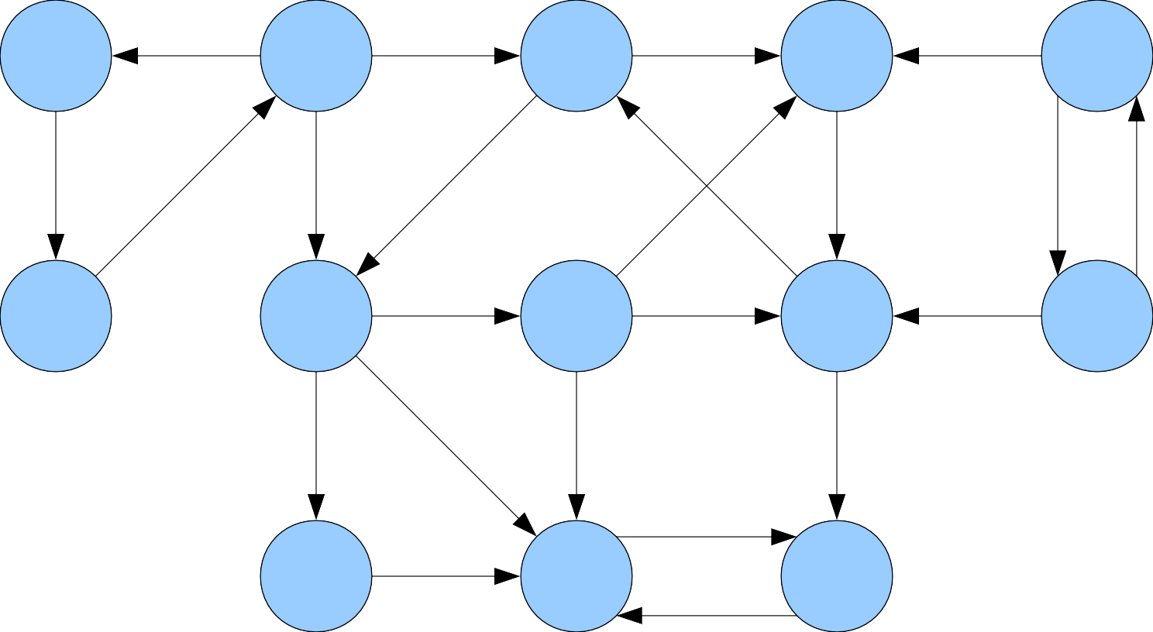

Slide 56
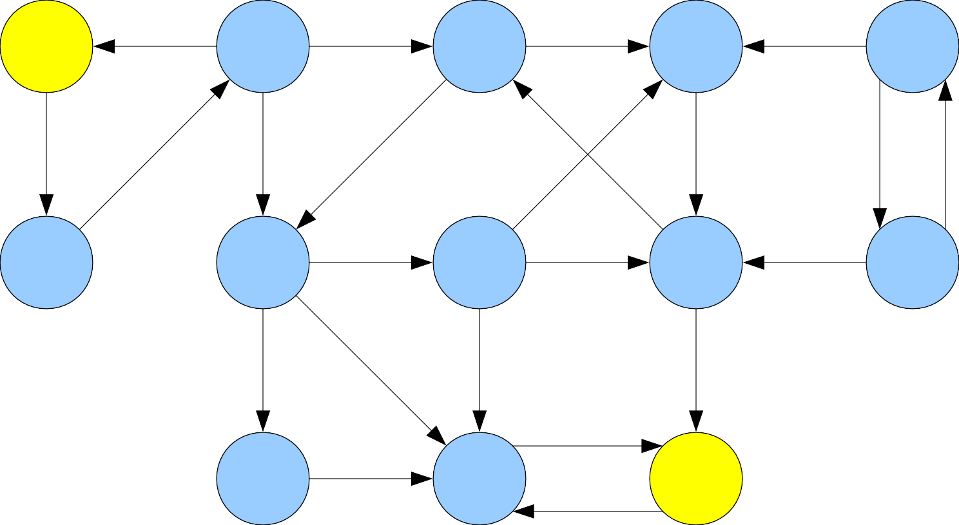
★
■

Slide 57
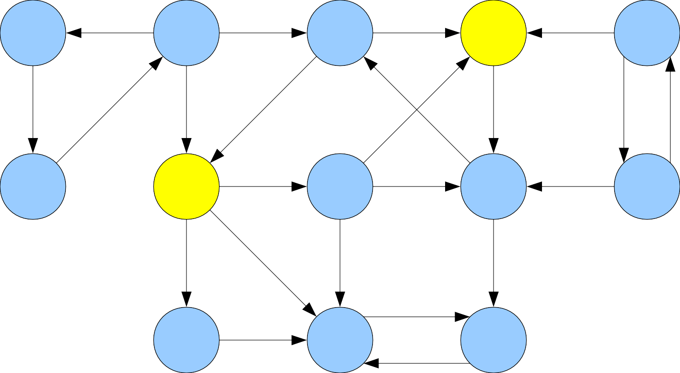
★
■

Slide 58
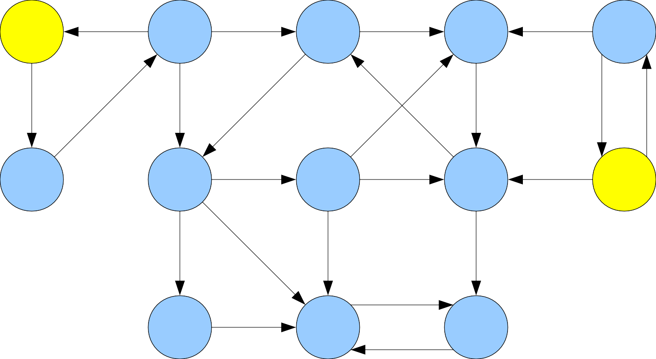
■
★

Slide 60
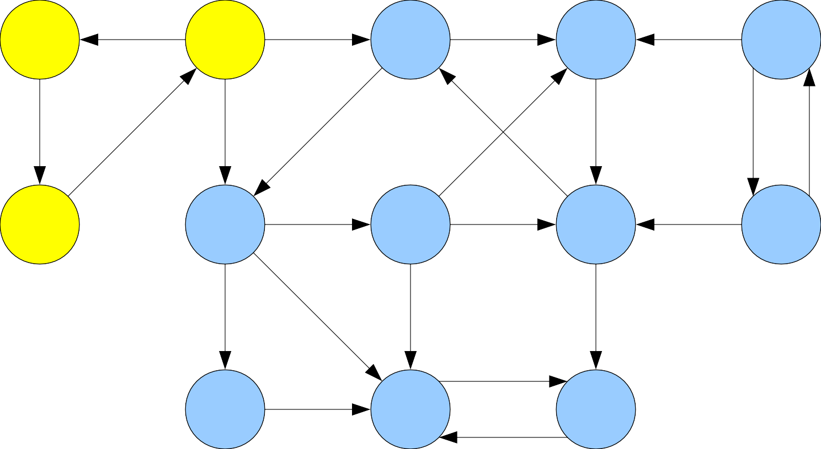

Slide 61
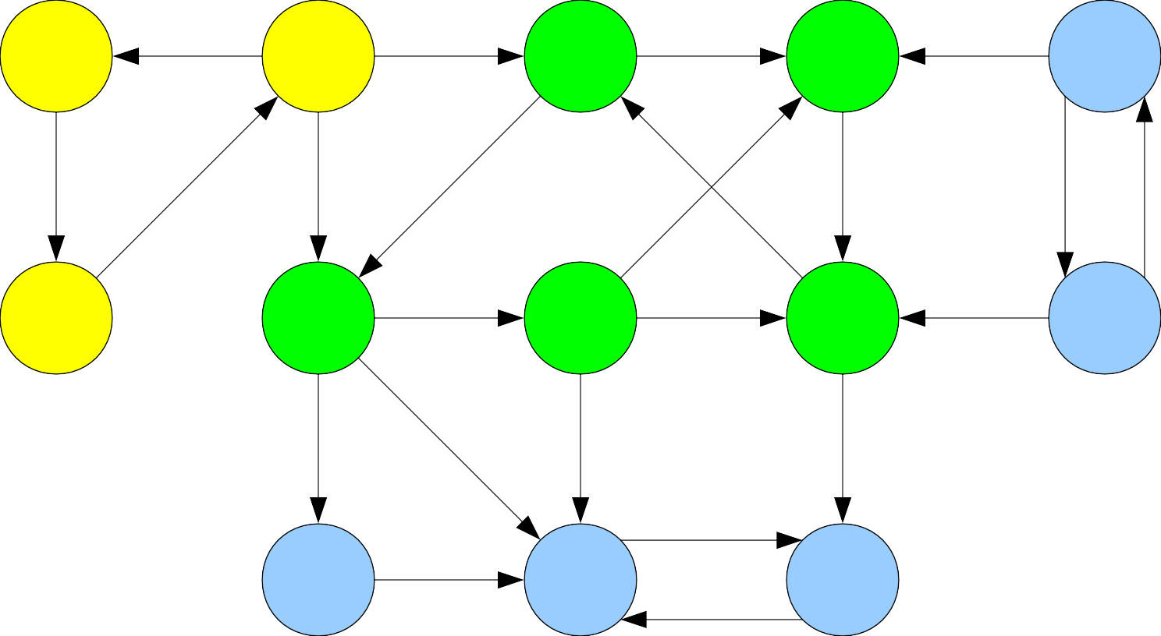

Slide 62
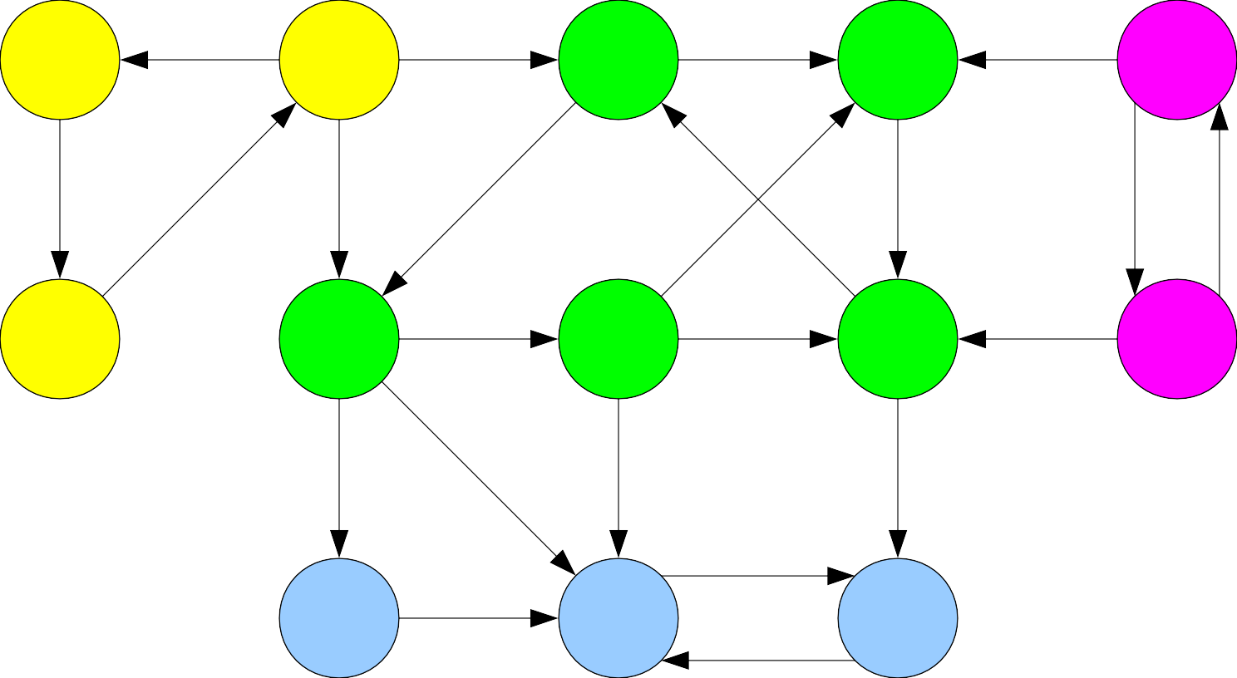

Slide 63


Slide 65
Strongly Connected Components
Let G = (V, E) be a directed graph.
Two nodes u, v ∈ V are called strongly connected iff v is reachable from u and u is reachable from v.
A strongly connected component (or SCC) of G is a set C ⊆ V such that
C is not empty.
For any u, v ∈ C: u and v are strongly connected.
For any u ∈ C and v ∈ V – C: u and v are not strongly connected.

Slide 72
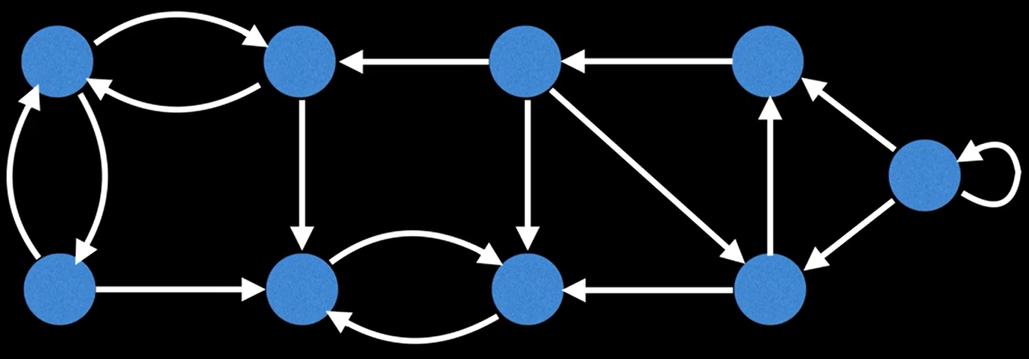
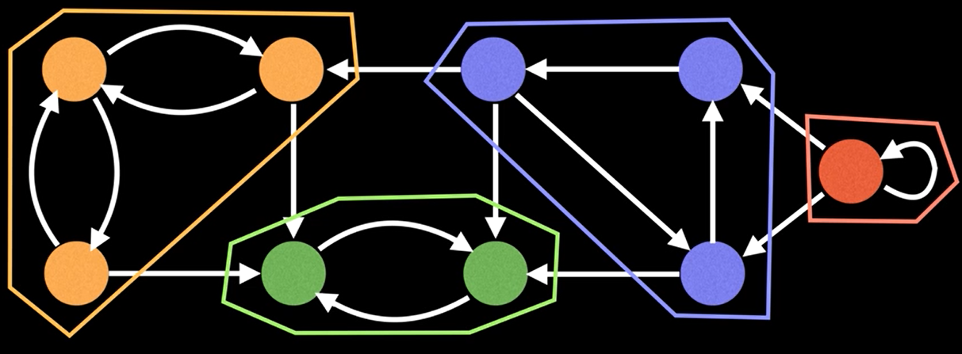

Slide 73
Properties of SCCs
The following properties of SCCs are true:
Two SCCs C₁ and C₂ are either equal or disjoint.
Every node belongs to exactly one SCC.
The SCCs of a graph form a partition of the nodes of the graph.

Slide 74
Finding SCCs
Every graph must have a collection of SCCs.
In the undirected case, it was easy to find all the connected components of a graph by using DFS or BFS.
Will this find all SCCs in a directed graph?
Question: How can we determine all of the strongly connected components of a directed graph G?

Slide 75
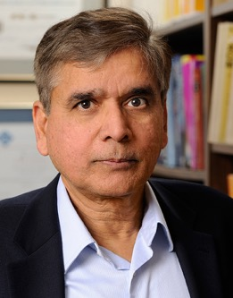
Kosaraju's Algorithm

Slide 76
procedure kosarajuSCC(graph G):
for each node v in G: color v gray. let L be an empty list. for each node v in G: if v is gray: run DFS starting at v, appending each node to list L when it is colored green. construct G^{R} from G. for each node v in GR: color v gray. let scc be a new array of length n let index = 0 for each node v in L, in reverse order: if v is gray: run DFS on v in GR, setting scc[u] = index for each node u colored green this way. index = index + 1 return scc

Slide 77
Transpose of a graph
Given a graph G, we can calculate the transpose of a graph G^{R} by reversing the direction of all the edges
G^{R}
G
A
A
B
B
D
D
E
E
C
C
Running time to calculate G^{R}?
O(|V| + |E|)

Slide 78
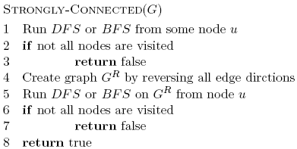
Runtime?
O(|V| + |E|)
O(|V|)
O(|V| + |E|)
O(|V| + |E|)
O(|V|)
O(|V| + |E|)

Slide 79
Strongly Connected Components
Let G = (V, E) be a directed graph.
Two nodes u, v ∈ V are called strongly connected iff v is reachable from u and u is reachable from v.
A strongly connected component (or
SCC) of G is a set C ⊆ V such that
●
●
●
C is not empty.
For any u, v ∈ C: u and v are strongly connected.
For any u ∈ C and v ∈ V – C: u and v are not strongly connected.
●
●
●

Slide 82
Condensation Graphs
The condensation of a directed graph G is the directed graph G^{SCC} whose nodes are the SCCs of G and whose edges are defined as follows:
(C₁, C₂) is an edge in G^{SCC} iff
∃u ∈ C₁, v ∈ C₂. (u, v) is an edge in G.
In other words, if there is an edge in G from any node in C₁ to any node in C₂, there is an edge in G^{SCC} from C₁ to C₂.
Theorem: G^{SCC} is a DAG for any graph G.

Slide 83
Strongly Connected Components
A directed graph G = (V, E) is strongly connected if,
for all pairs of vertices u and v, there’s a path from u to v
and a path from v to u.

Slide 84
Strongly Connected Components
A directed graph G = (V, E) is strongly connected if,
for all pairs of vertices u and v, there’s a path from u to v
and a path from v to u.

Slide 85
Strongly Connected Components
We can decompose a graph into its strongly connected components (SCCs).

Slide 86
How do we find all the SCCs of a graph?

Slide 87
Strongly Connected Components
Why do we care about SCCs?
SCCs provide information about communities.
A computer scientist might want to decompose the Internet into SCCs to find related topics.
An economist might want to decompose labor market data into SCCs before making sense of it.
…

Slide 88






Strongly Connected Components
How many SCCs are in this graph?

Slide 89
Strongly Connected Components
How many SCCs are in this graph? 3; let’s find them!

Slide 90
Kosaraju’s Algorithm
1. Repeat dfs from an arbitrary vertex until done.

Slide 91
Kosaraju’s Algorithm
1. Repeat dfs from an arbitrary vertex until done.
start_time: 0
end_time: 1

Slide 92
Kosaraju’s Algorithm
1. Repeat dfs from an arbitrary vertex until done.
start_time: 0
end_time: 1

Slide 93
Kosaraju’s Algorithm
1. Repeat dfs from an arbitrary vertex until done.
start_time: 0
end_time: 1
start_time: 2
end_time: 7

Slide 94
Kosaraju’s Algorithm
1. Repeat dfs from an arbitrary vertex until done.
start_time: 3
end_time: 6
start_time: 0
end_time: 1
start_time: 2
end_time: 7

Slide 95
Kosaraju’s Algorithm
1. Repeat dfs from an arbitrary vertex until done.
start_time: 3
end_time: 6
start_time: 0
end_time: 1
start_time: 2
end_time: 7
start_time: 4
end_time: 5

Slide 96
Kosaraju’s Algorithm
1. Repeat dfs from an arbitrary vertex until done.
start_time: 3
end_time: 6
start_time: 0
end_time: 1
start_time: 2
end_time: 7
start_time: 4
end_time: 5

Slide 97
Kosaraju’s Algorithm
1. Repeat dfs from an arbitrary vertex until done.
start_time: 3
end_time: 6
start_time: 0
end_time: 1
start_time: 2
end_time: 7
start_time: 4
end_time: 5

Slide 98
Kosaraju’s Algorithm
1. Repeat dfs from an arbitrary vertex until done.
start_time: 3
end_time: 6
start_time: 0
end_time: 1
start_time: 2
end_time: 7
start_time: 4
end_time: 5

Slide 99
Kosaraju’s Algorithm
1. Repeat dfs from an arbitrary vertex until done.
start_time: 3
end_time: 6
start_time: 0
end_time: 1
start_time: 2
end_time: 7
start_time: 4
end_time: 5
start_time: 8
end_time: 9

Slide 100
Kosaraju’s Algorithm
1. Repeat dfs from an arbitrary vertex until done.
start_time: 3
end_time: 6
start_time: 0
end_time: 1
start_time: 2
end_time: 7
start_time: 4
end_time: 5
start_time: 8
end_time: 9

Slide 101
Kosaraju’s Algorithm
2. Reverse all of the edges.
start_time: 3
end_time: 6
start_time: 0
end_time: 1
start_time: 2
end_time: 7
start_time: 4
end_time: 5
start_time: 8
end_time: 9

Slide 102
Kosaraju’s Algorithm
2. Reverse all of the edges.
start_time: 3
end_time: 6
start_time: 0
end_time: 1
start_time: 2
end_time: 7
start_time: 4
end_time: 5
start_time: 8
end_time: 9

Slide 103
Kosaraju’s Algorithm
3. Repeat dfs again, starting with vertices with the largest end_time.
start_time: 3
end_time: 6
start_time: 0
end_time: 1
start_time: 2
end_time: 7
start_time: 4
end_time: 5
start_time: 8
end_time: 9

Slide 104
Kosaraju’s Algorithm
3. Repeat dfs again, starting with vertices with the largest end_time.
start_time: 3
end_time: 6
start_time: 0
end_time: 1
start_time: 2
end_time: 7
start_time: 4
end_time: 5
start_time: 8
end_time: 9

Slide 105
Kosaraju’s Algorithm
3. Repeat dfs again, starting with vertices with the largest end_time.
start_time: 3
end_time: 6
start_time: 0
end_time: 1
start_time: 2
end_time: 7
start_time: 4
end_time: 5
start_time: 8
end_time: 9
This is one SCC.

Slide 106
Kosaraju’s Algorithm
3. Repeat dfs again, starting with vertices with the largest end_time.
start_time: 3
end_time: 6
start_time: 0
end_time: 1
start_time: 2
end_time: 7
start_time: 4
end_time: 5
start_time: 8
end_time: 9
This is one SCC.

Slide 107
Kosaraju’s Algorithm
3. Repeat dfs again, starting with vertices with the largest end_time.
start_time: 3
end_time: 6
start_time: 0
end_time: 1
start_time: 2
end_time: 7
start_time: 4
end_time: 5
start_time: 8
end_time: 9
This is one SCC.

Slide 108
Kosaraju’s Algorithm
3. Repeat dfs again, starting with vertices with the largest end_time.
start_time: 3
end_time: 6
start_time: 0
end_time: 1
start_time: 2
end_time: 7
start_time: 4
end_time: 5
start_time: 8
end_time: 9
This is one SCC.

Slide 109
Kosaraju’s Algorithm
3. Repeat dfs again, starting with vertices with the largest end_time.
start_time: 3
end_time: 6
start_time: 0
end_time: 1
start_time: 2
end_time: 7
start_time: 4
end_time: 5
start_time: 8
end_time: 9
This is one SCC.

Slide 110
Kosaraju’s Algorithm
3. Repeat dfs again, starting with vertices with the largest end_time.
start_time: 3
end_time: 6
start_time: 0
end_time: 1
start_time: 2
end_time: 7
start_time: 4
end_time: 5
start_time: 8
end_time: 9
This is one SCC.

Slide 111
Kosaraju’s Algorithm
3. Repeat dfs again, starting with vertices with the largest end_time.
start_time: 3
end_time: 6
start_time: 0
end_time: 1
start_time: 2
end_time: 7
start_time: 4
end_time: 5
start_time: 8
end_time: 9
This is one SCC.

Slide 112
Kosaraju’s Algorithm
3. Repeat dfs again, starting with vertices with the largest end_time.
start_time: 3
end_time: 6
start_time: 0
end_time: 1
start_time: 2
end_time: 7
start_time: 4
end_time: 5
start_time: 8
end_time: 9
Here’s another SCC!
This is one SCC.

Slide 113
Kosaraju’s Algorithm
3. Repeat dfs again, starting with vertices with the largest end_time.
start_time: 3
end_time: 6
start_time: 0
end_time: 1
start_time: 2
end_time: 7
start_time: 4
end_time: 5
start_time: 8
end_time: 9
Here’s another SCC!
This is one SCC.

Slide 114
Kosaraju’s Algorithm
3. Repeat dfs again, starting with vertices with the largest end_time.
start_time: 3
end_time: 6
start_time: 0
end_time: 1
start_time: 2
end_time: 7
start_time: 4
end_time: 5
start_time: 8
end_time: 9
Here’s another SCC!
This is one SCC.

Slide 115
Kosaraju’s Algorithm
3. Repeat dfs again, starting with vertices with the largest end_time.
start_time: 3
end_time: 6
Here’s the last one.
start_time: 0
end_time: 1
start_time: 2
end_time: 7
start_time: 4
end_time: 5
start_time: 8
end_time: 9
Here’s another SCC!
This is one DFS tree.

Slide 116
Kosaraju’s Algorithm
Whoa. How did that work?
Lemma 1: The SCC metagraph is a DAG.
Intuition: If not, then two SCCs would collapse into one.

Slide 117
SCCs and DAGs

Slide 118
Condensation Graphs
The condensation of a directed graph G is the directed graph G^{SCC} whose nodes are the SCCs of G and whose edges are defined as follows:
(C₁, C₂) is an edge in G^{SCC} iff ∃u ∈ C₁, v ∈ C₂. (u, v) is an edge in G.
In other words, if there is an edge in G from any node in C₁ to any node in C₂, there is an edge in G^{SCC} from C₁ to C₂.

Slide 119
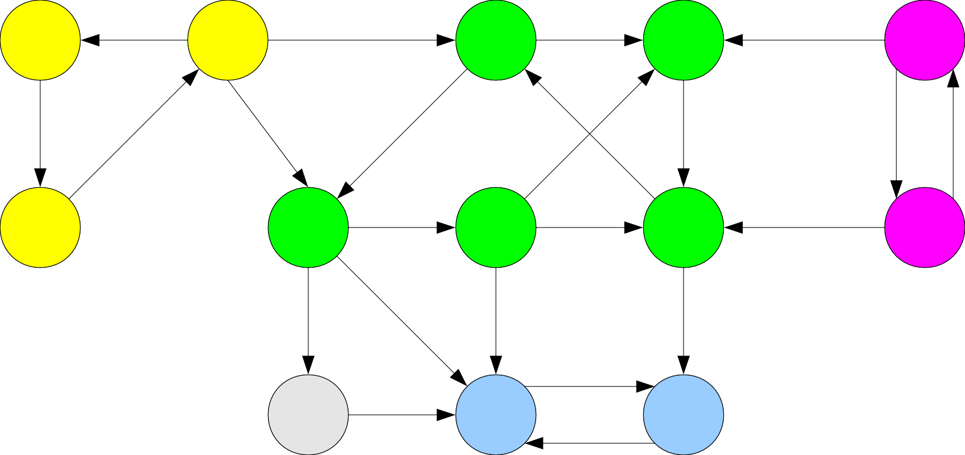

Slide 124
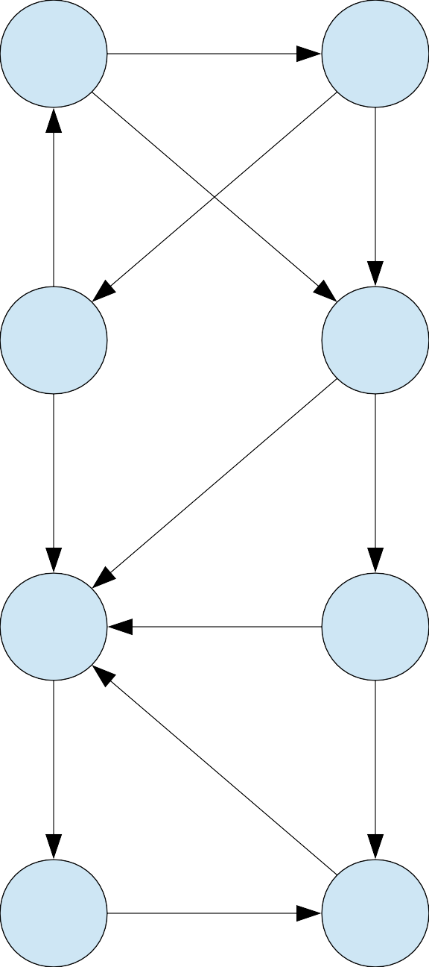

Slide 125
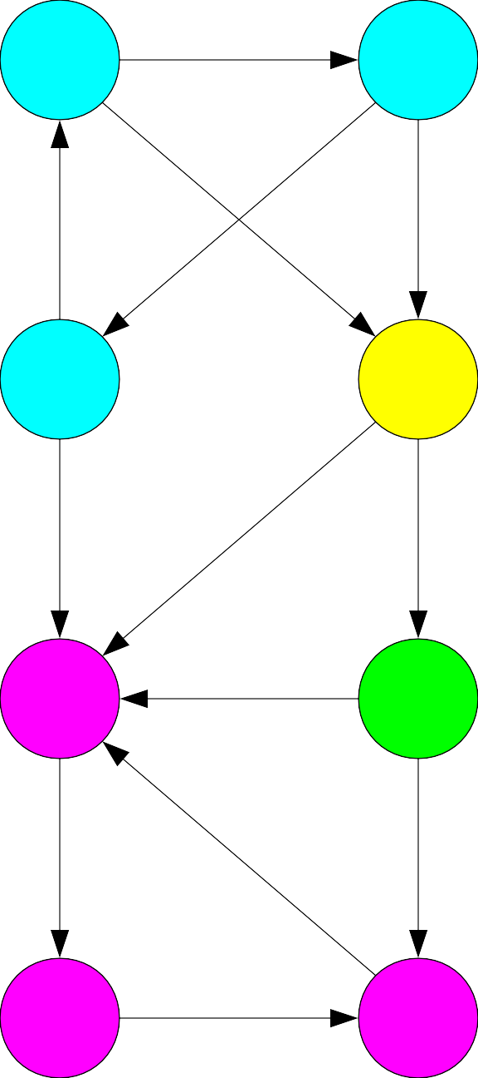

Slide 132
An Amazing Result
●
Theorem: For any directed graph G, the condensation G^{SCC} of G is a DAG.
Proof Sketch:
●
Notes:
Therefore, u and v′ are reachable from each other, so they are not in separate SCC’s

Slide 133
Conclusion
Theorem: For any directed graph G, the condensation G^{SCC} of G is a DAG.
Proof Sketch:

Slide 134
An Amazing Result
Theorem: For any directed graph G, the condensation G^{SCC} of G is a DAG.
Proof Sketch:

Slide 135
SCCs and DAGs
We now see that there is a close connection between SCCs and DAGs: the SCCs of a graph form a DAG.
Intuitively, you can think of a graph as a two-layer structure:
At a high level, a graph is a DAG of SCCs showing the top-level connections between clusters of nodes.
At a lower level, you can see the connections between nodes in the same SCC.

Slide 136
SCCs and DAGs
Now that we have found a connection between SCCs and DAGs, can we adapt any of our algorithms on DAGs to find SCCs?
Right now, our main operation on DAGs is topological sort, and we have two algorithms we can use:
Repeatedly removing a source node. That won't help us here, since we can't easily tell if a node is in a source SCC.
Running DFS and reversing the result. So what happens if we try that out?

Slide 137
Kosaraju’s Algorithm
Let the end time of a SCC be the largest end time of any element of that SCC.
Let the starting time of a SCC be the smallest starting time of any element of that SCC.
start_time: 3
end_time: 6
start_time: 4
end_time: 5
start_time: 2
end_time: 7
start_time: 0
end_time: 1
start_time: 8
end_time: 9
start_time: 2
end_time: 7

Slide 138
Kosaraju’s Algorithm
The main idea leverages the fact that vertex in the SCC metagraph with the largest end_time has no incoming
edges.
start_time: 0
end_time: 1
start_time: 2
end_time: 7
start_time: 8
end_time: 9

Slide 139
Kosaraju’s Algorithm
The main idea leverages the fact that vertex in the SCC metagraph with the largest end_time has no incoming
edges. After reversing the edges, it has no outgoing edges.
start_time: 0
end_time: 1
start_time: 2
end_time: 7
start_time: 8
end_time: 9

Slide 140
Kosaraju’s Algorithm
The main idea leverages the fact that vertex in the SCC metagraph with the largest end_time has no incoming
edges. After reversing the edges, it has no outgoing edges.
Running dfs on that vertex finds exactly that component.
start_time: 0
end_time: 1
start_time: 2
end_time: 7
start_time: 8
end_time: 9

Slide 141
Kosaraju’s Algorithm
The main idea leverages the fact that vertex in the SCC metagraph with the largest end_time has no incoming
edges. After reversing the edges, it has no outgoing edges.
Running dfs on that vertex finds exactly that component.
Same argument for the rest.
start_time: 0
end_time: 1
start_time: 2
end_time: 7
start_time: 8
end_time: 9

Slide 142
Kosaraju’s Algorithm
The main idea leverages the fact that vertex in the SCC metagraph with the largest end_time has no incoming
edges. After reversing the edges, it has no outgoing edges.
Running dfs on that vertex finds exactly that component.
Same argument for the rest.
start_time: 0
end_time: 1
start_time: 2
end_time: 7
start_time: 8
end_time: 9

Slide 143
Kosaraju’s Algorithm
The main idea leverages the fact that vertex in the SCC metagraph with the largest end_time has no incoming
edges. After reversing the edges, it has no outgoing edges.
Running dfs on that vertex finds exactly that component.
Same argument for the rest.
start_time: 0
end_time: 1
start_time: 2
end_time: 7
start_time: 8
end_time: 9

Slide 144
Kosaraju’s Algorithm
Claim: For each edge (u, v) in the SCC metagraph where u ∈ C₁ and v ∈ C₂, end_time of C₁ must be larger than end_time of C₂.
start_time: 0
end_time: 1
start_time: 2
end_time: 7
start_time: 8
end_time: 9

Slide 145
Kosaraju’s Algorithm
Claim: For each edge (u, v) in the SCC metagraph where u ∈ C₁ and v ∈ C₂, end_time of C₁ must be larger than end_time of C₂.
start_time: 0
end_time: 1
start_time: 2
end_time: 7
start_time: 8
end_time: 9

Slide 146
Kosaraju’s Algorithm
Claim: For each edge (u, v) in the SCC metagraph where u ∈ C₁ and v ∈ C₂, end_time of C₁ must be larger than end_time of C₂.
start_time: 0
end_time: 1
start_time: 2
end_time: 7
start_time: 8
end_time: 9

Slide 147
Kosaraju’s Algorithm
Claim: For each edge (u, v) in the SCC metagraph where u ∈ C₁ and v ∈ C₂, end_time of C₁ must be larger than end_time of C₂.
start_time: 0
end_time: 1
start_time: 2
end_time: 7
start_time: 8
end_time: 9

Slide 148
Kosaraju’s Algorithm
Claim: For each edge (u, v) in the SCC metagraph where u ∈ C₁ and v ∈ C₂, end_time of C₁ must be larger than end_time of C₂.
C₁
C₂
start_time: 0
end_time: 1
start_time: 2
end_time: 7

Slide 149
Kosaraju’s Algorithm
Claim: For each edge (u, v) in the SCC metagraph where u ∈ C₁ and v ∈ C₂, end_time of C₁ must be larger than end_time of C₂.
Intuition: In order for the end_time of C₁ to be smaller than the end_time of
C₂, all vertices in C₁ must have end_times smaller than at least one end_time
of C₂.
C₁
C₂
start_time: 0
end_time: 1
start_time: 2
end_time: 7

Slide 150
Kosaraju’s Algorithm
Claim: For each edge (u, v) in the SCC metagraph where u ∈ C₁ and v ∈ C₂, end_time of C₁ must be larger than end_time of C₂.
Intuition: In order for the end_time of C₁ to be smaller than the end_time of
C₂, all vertices in C₁ must have end_times smaller than at least one end_time
of C₂.
For this to occur, the first dfs must have marked all vertices in C₁ as “done” before at least one vertex in C₂.
C₁
C₂
start_time: 0
end_time: 1
start_time: 2
end_time: 7

Slide 151
Kosaraju’s Algorithm
Claim: For each edge (u, v) in the SCC metagraph where u ∈ C₁ and v ∈ C₂, end_time of C₁ must be larger than end_time of C₂.
Intuition: In order for the end_time of C₁ to be smaller than the end_time of
C₂, all vertices in C₁ must have end_times smaller than at least one end_time
of C₂.
For this to occur, the first dfs must have marked all vertices in C₁ as “done” before at least one vertex in C₂. But this is impossible since the first dfs must
have explored edge (u, v) before marking all vertices in C₁ as “done.”
C₁
C₂
start_time: 0
end_time: 1
start_time: 2
end_time: 7

Slide 152
Kosaraju’s Algorithm
Claim: For each edge (u, v) in the SCC metagraph where u ∈ C₁ and v ∈ C₂, end_time of C₁ must be larger than end_time of C₂.
Intuition: In order for the end_time of C₁ to be smaller than the end_time of
C₂, all vertices in C₁ must have end_times smaller than at least one end_time
of C₂.
For this to occur, the first dfs must have marked all vertices in C₁ as “done” before at least one vertex in C₂. But this is impossible since the first dfs must
have explored edge (u, v) before marking all vertices in C₁ as “done.” Since C₂
is an SCC, all vertices in it are reachable from v; therefore, all must have an end_time smaller than u.
C₁
C₂
start_time: 0
end_time: 1
start_time: 2
end_time: 7

Slide 153
Example 2

Slide 154
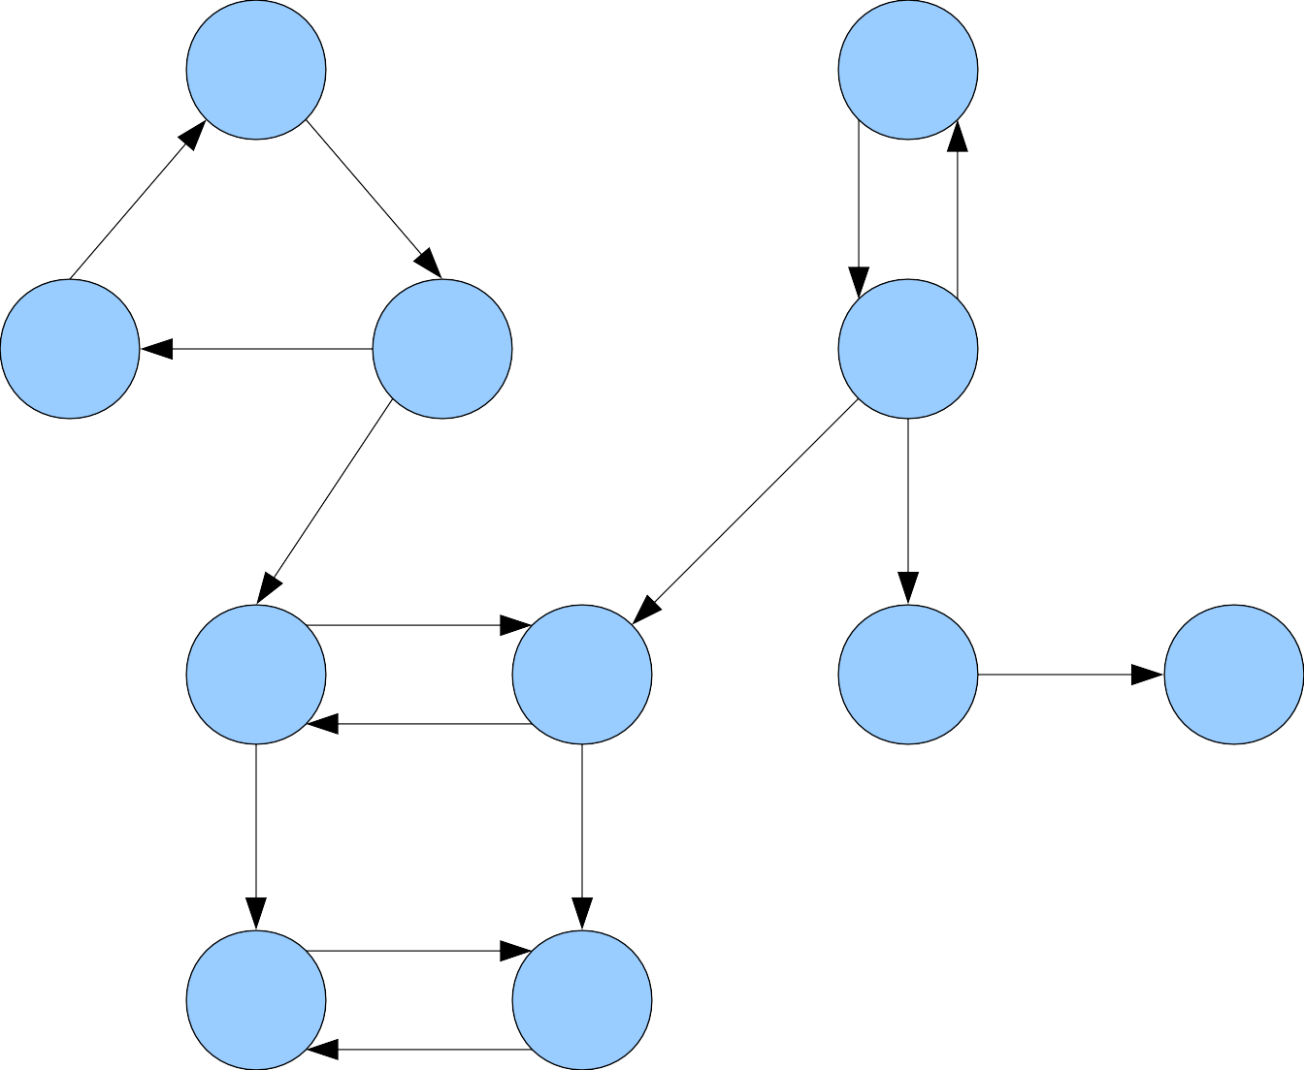
A |  |  | B
C | D |  | E
F |  | G | H I
J |  | K

Slide 155
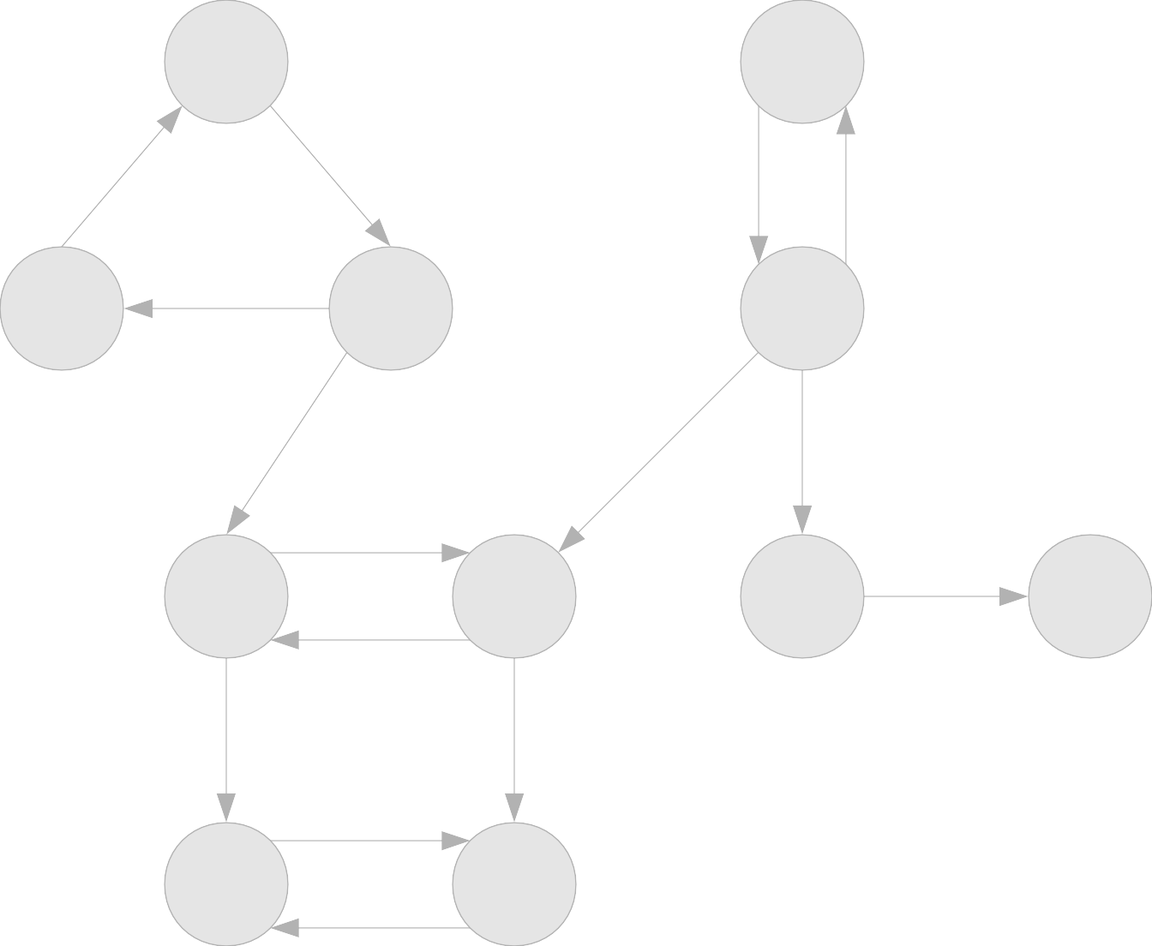
A |  |  | B
C | D |  | E
F |  | G | H I
J |  | K

Slide 156
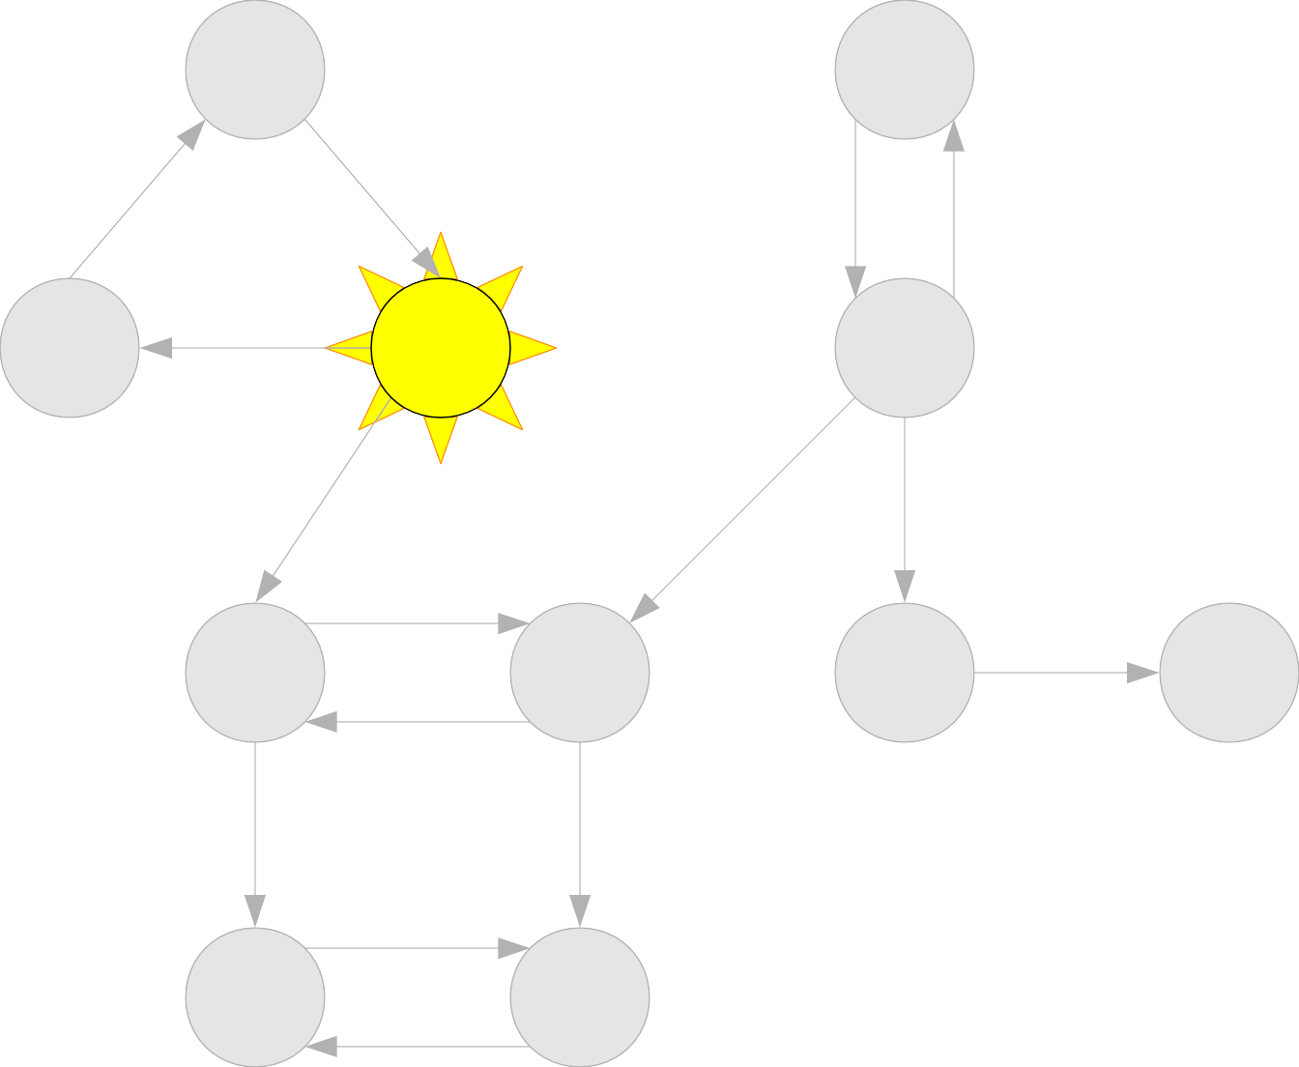
A |  |  | B
C | D |  | E
F |  | G | H I
J |  | K

Slide 157
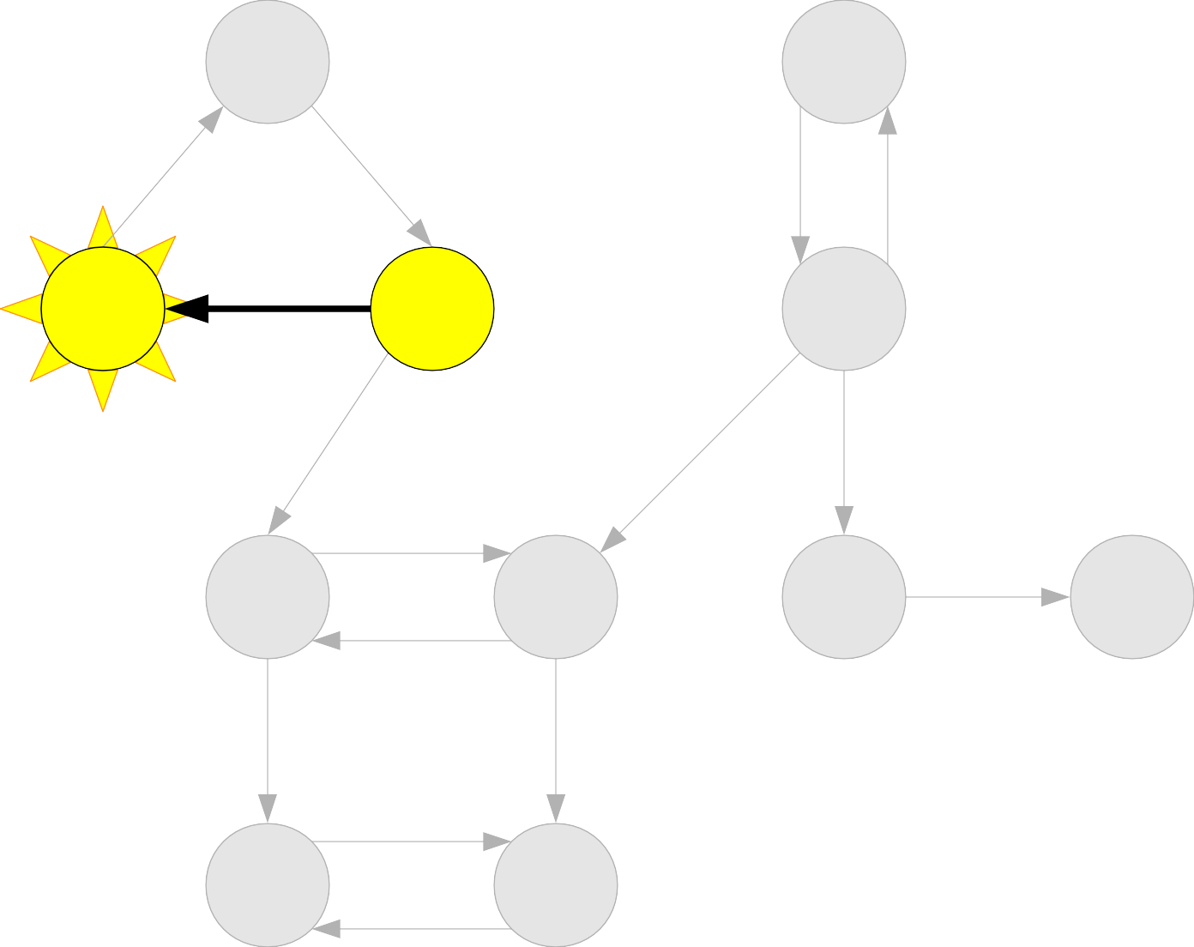
A |  |  | B
C | D |  | E
F |  | G | H I
J |  | K

Slide 158
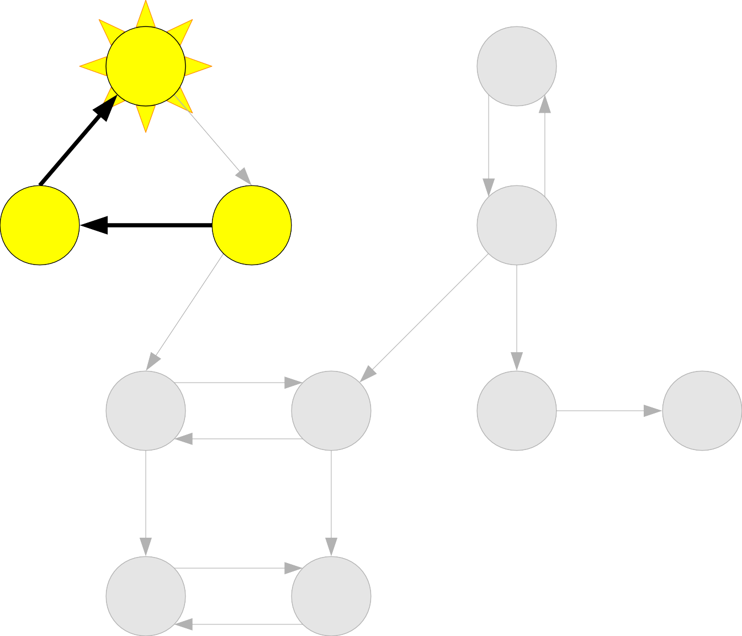
A |  |  | B
C | D |  | E
F |  | G | H I
J |  | K

Slide 159
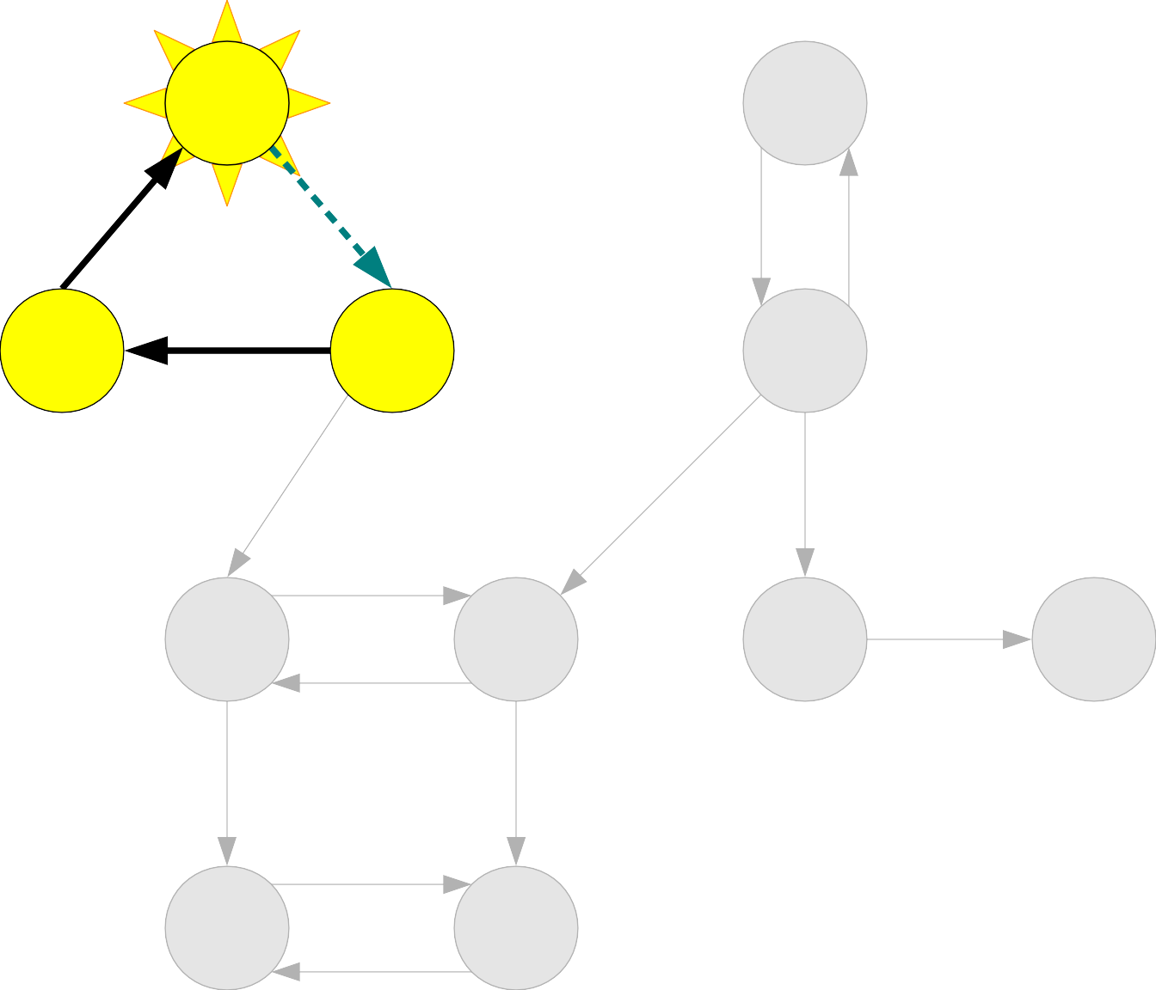
A |  |  | B
C | D |  | E
F |  | G | H I
J |  | K

Slide 160
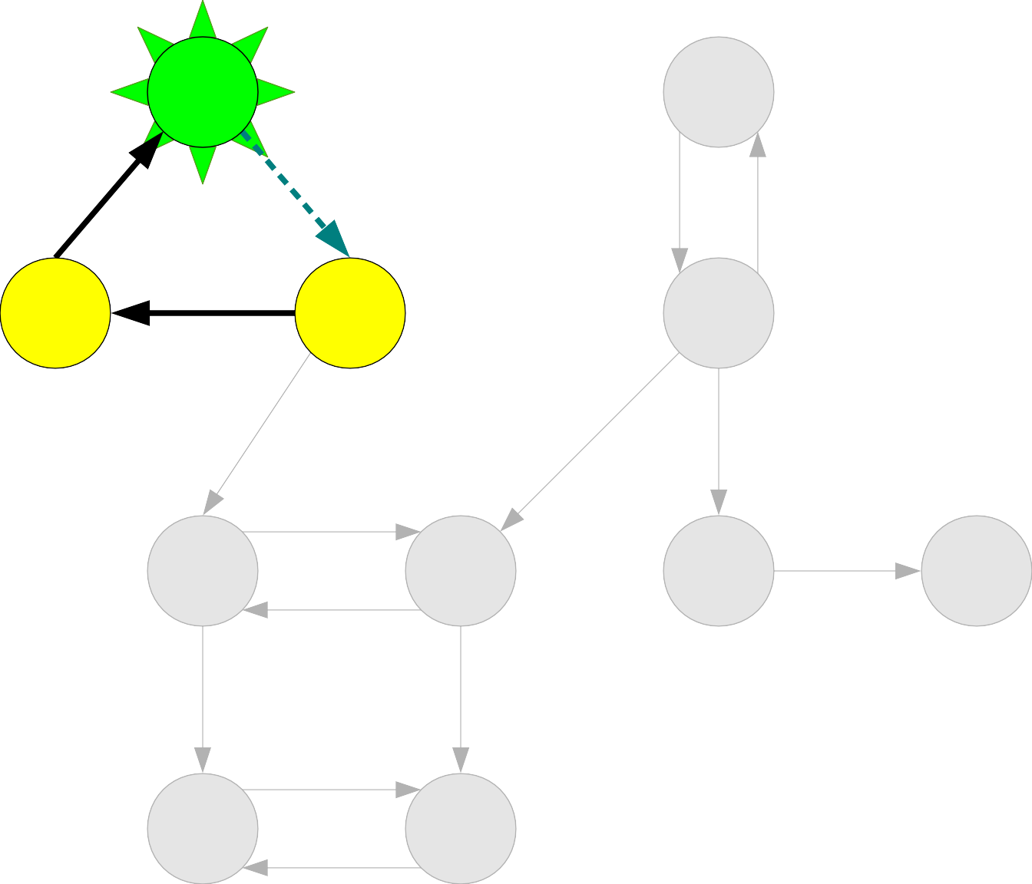
A |  |  | B
C | D |  | E
F |  | G | H I
J |  | K

Slide 161
A |  |  | B
C | D |  | E
F |  | G | H I
J |  | K
A

Slide 162
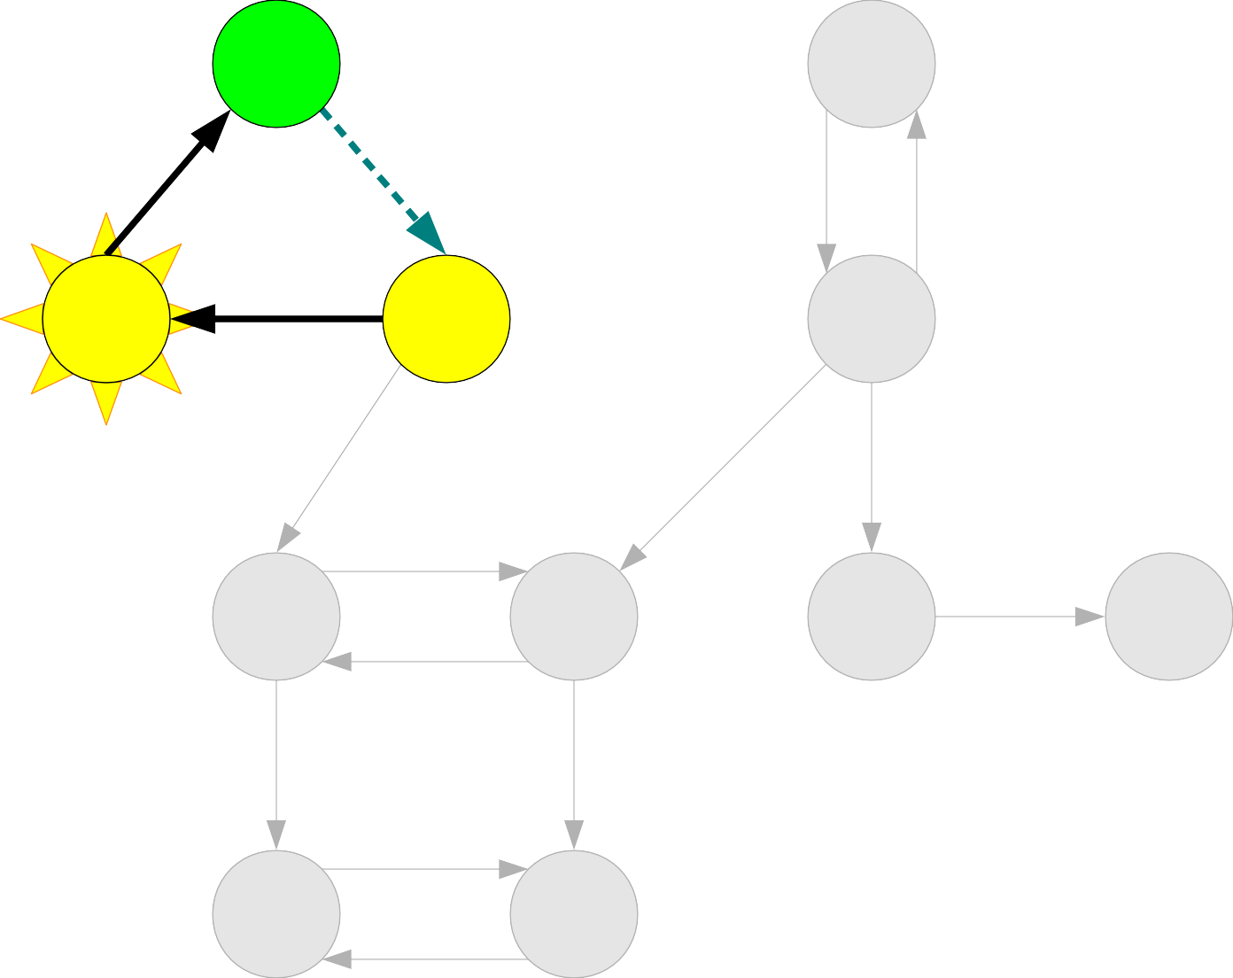
A |  |  | B
C | D |  | E
F |  | G | H I
J |  | K
A

Slide 163
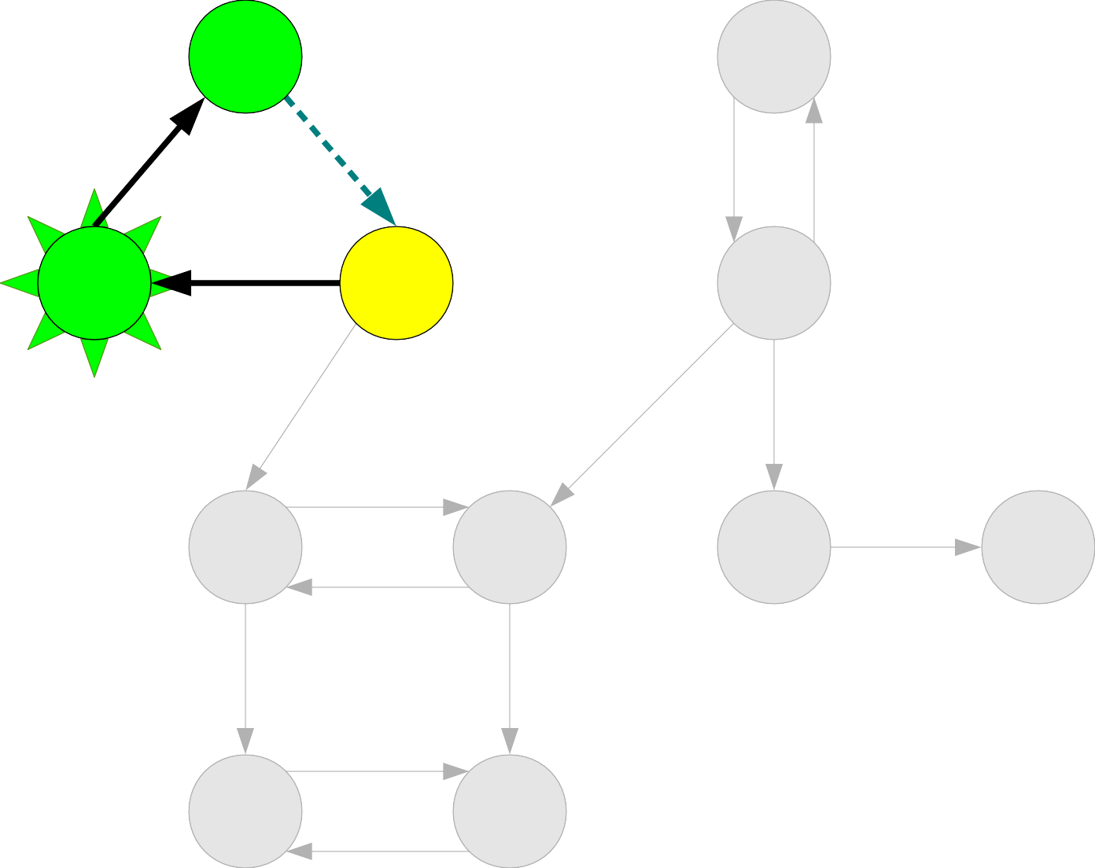
A |  |  | B
C | D |  | E
F |  | G | H I
J |  | K
A

Slide 164
A |  |  | B
C | D |  | E
F |  | G | H I
J |  | K
A
C

Slide 165
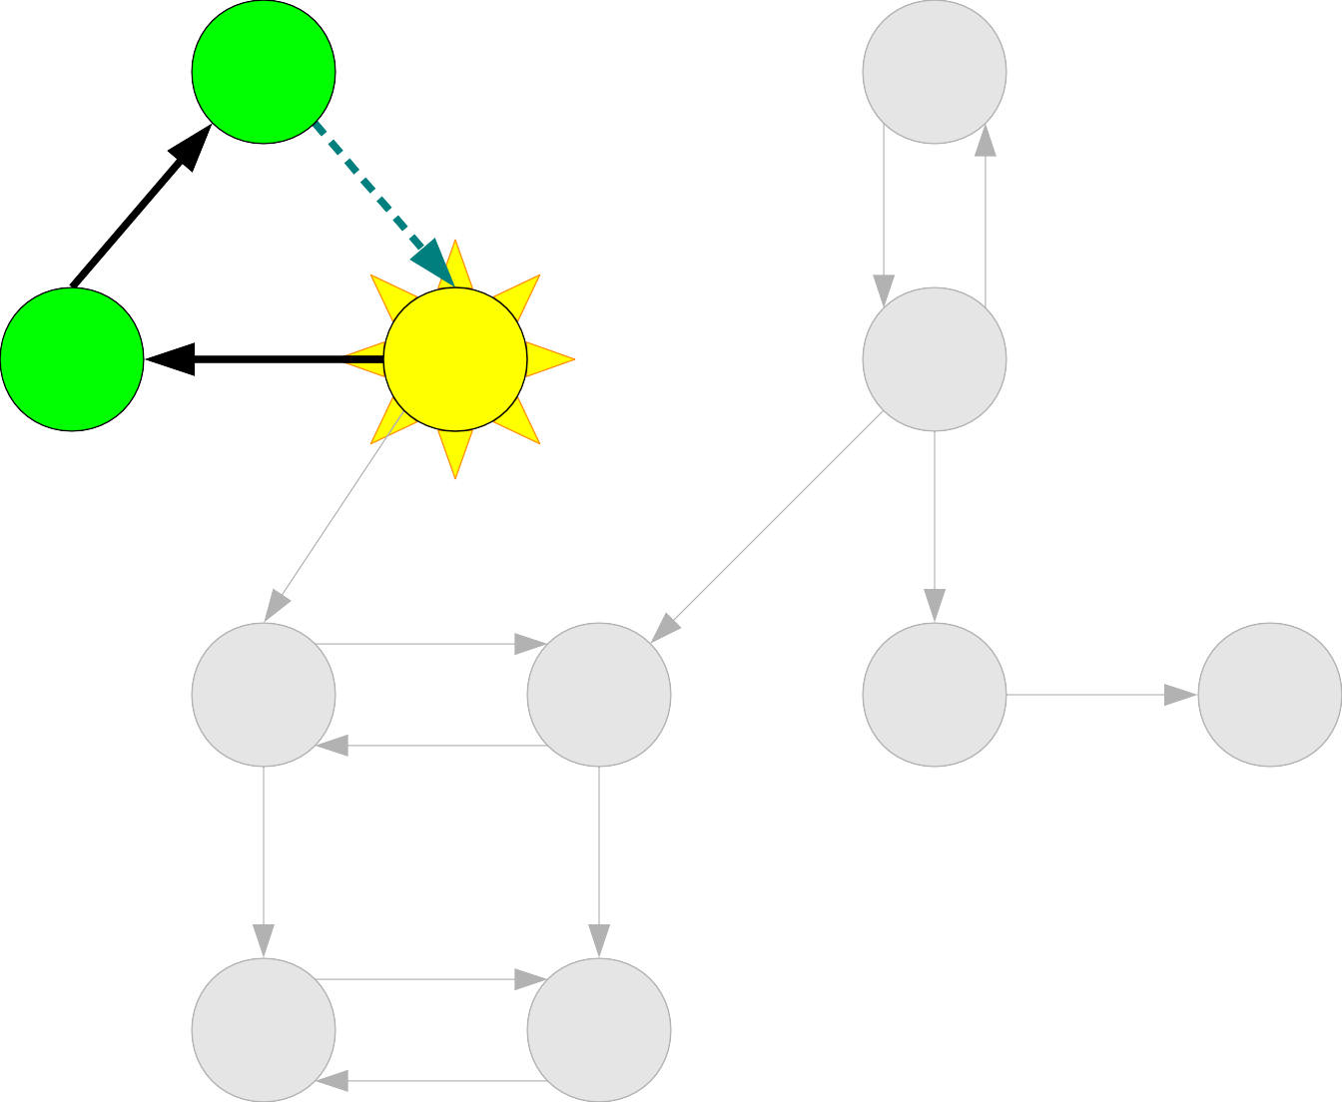
A |  |  | B
C | D |  | E
F |  | G | H I
J |  | K
A
C

Slide 166
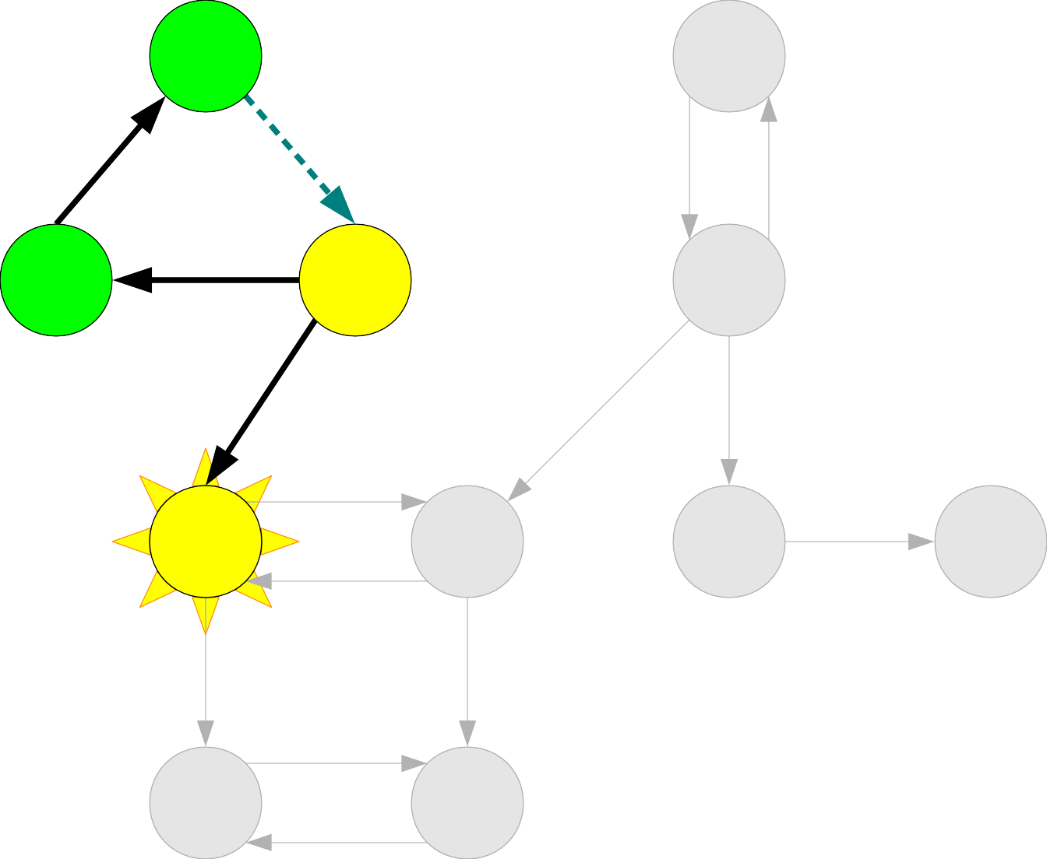
A |  |  | B
C | D |  | E
F |  | G | H I
J |  | K
A
C

Slide 167
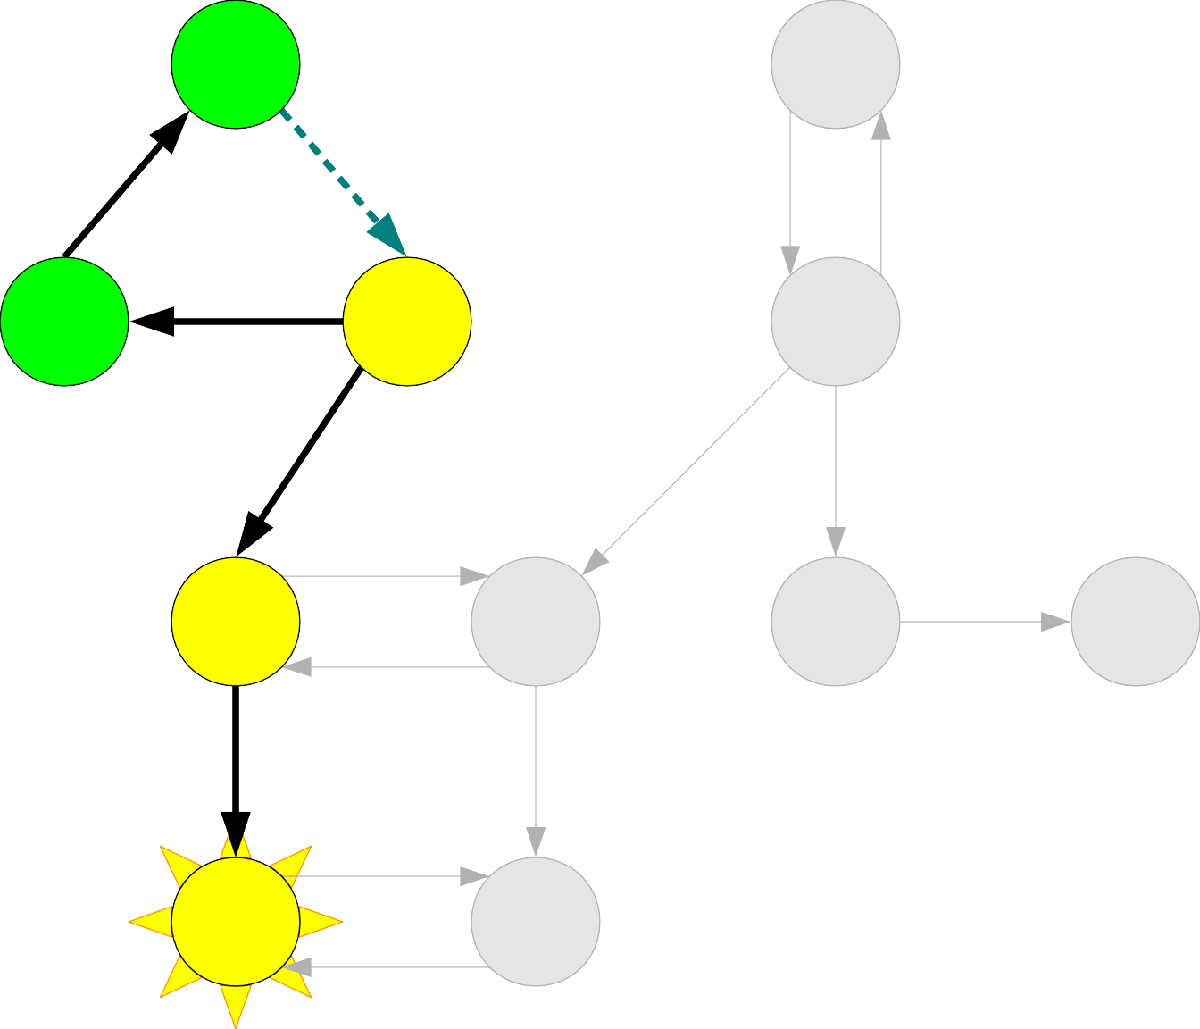
A |  |  | B
C | D |  | E
F |  | G | H I
J |  | K
A
C

Slide 168
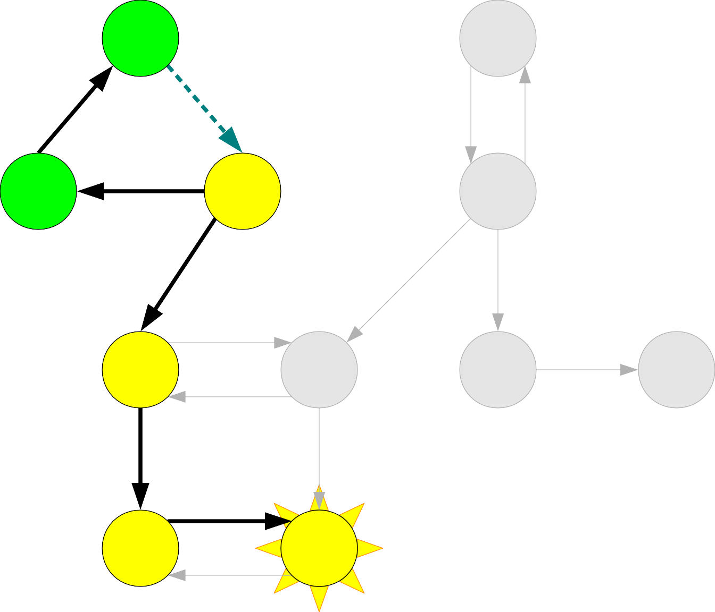
A |  |  | B
C | D |  | E
F |  | G | H I
J |  | K
A
C

Slide 169
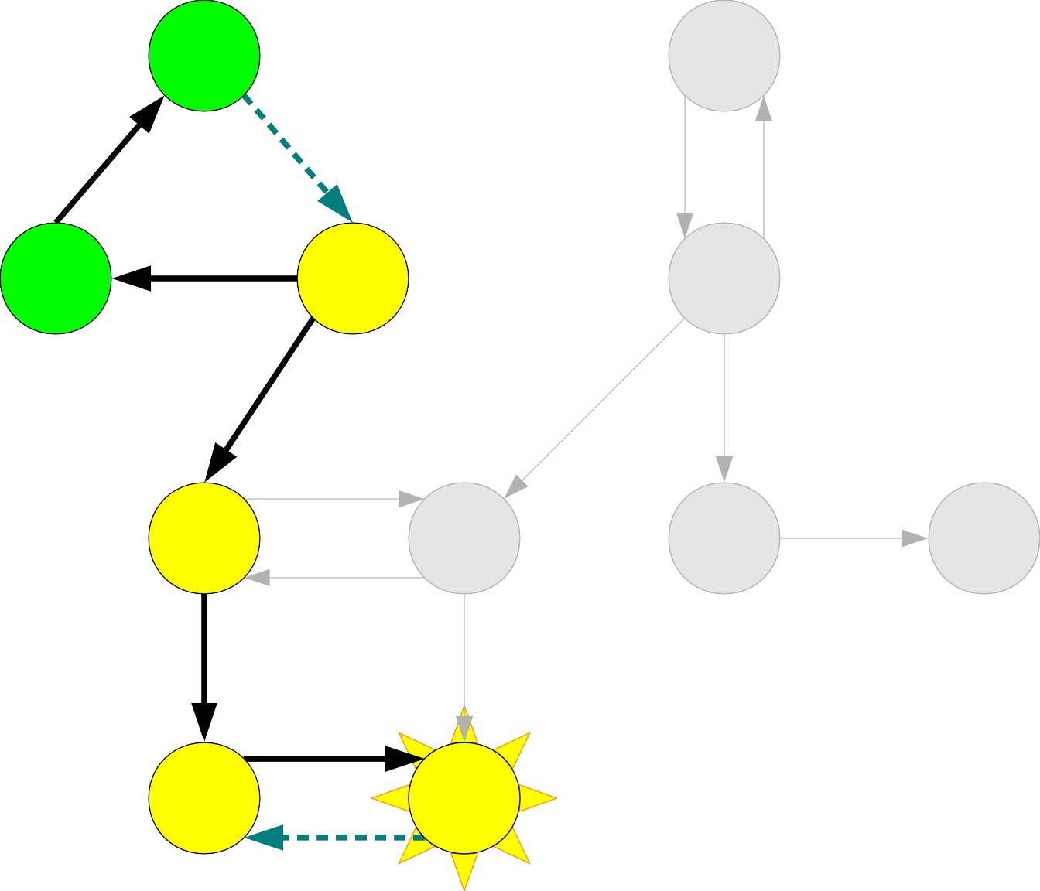
A |  |  | B
C | D |  | E
F |  | G | H I
J |  | K
A
C

Slide 170
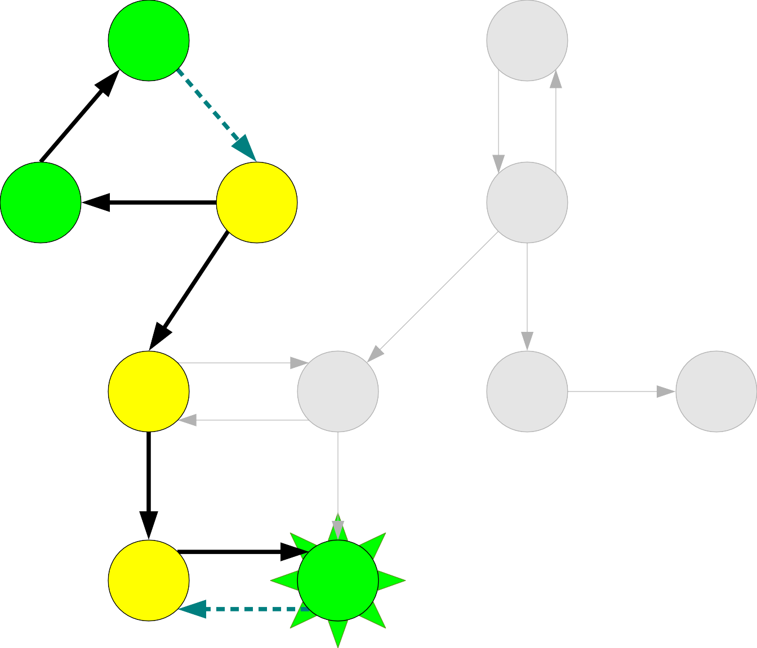
A |  |  | B
C | D |  | E
F |  | G | H I
J |  | K
A
C

Slide 171
A |  |  | B
C | D |  | E
F |  | G | H I
J |  | K
A
C
K

Slide 172
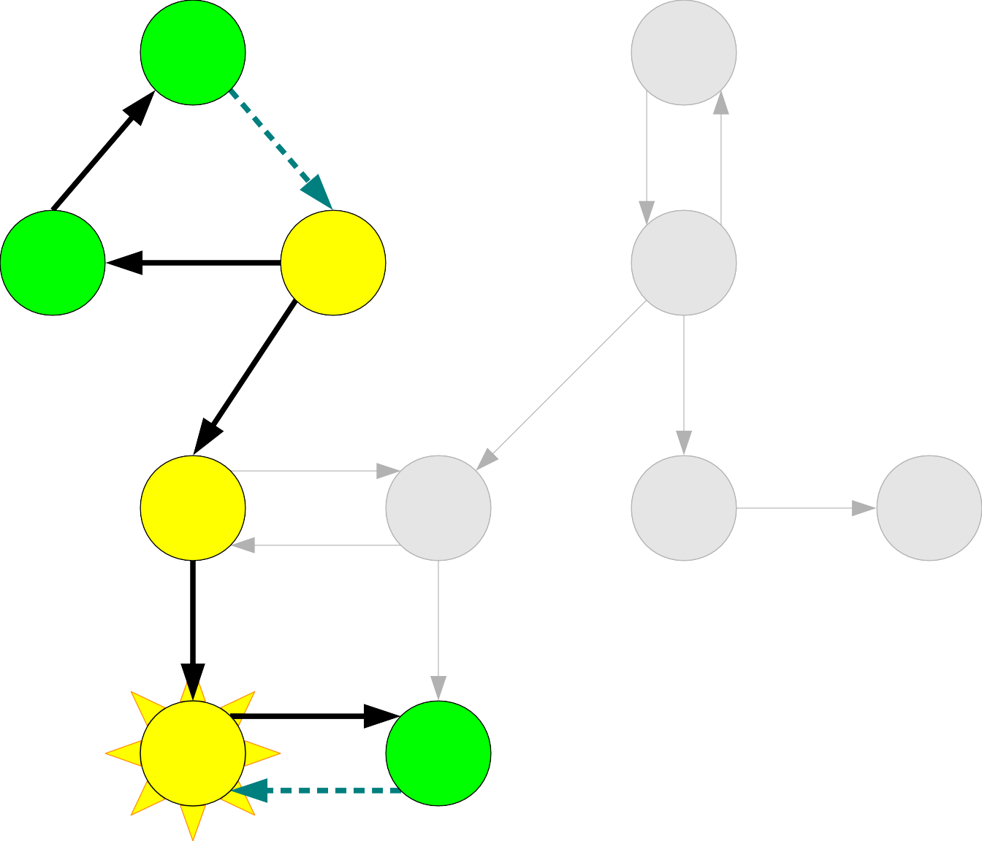
A |  |  | B
C | D |  | E
F |  | G | H I
J |  | K
A
C
K

Slide 173
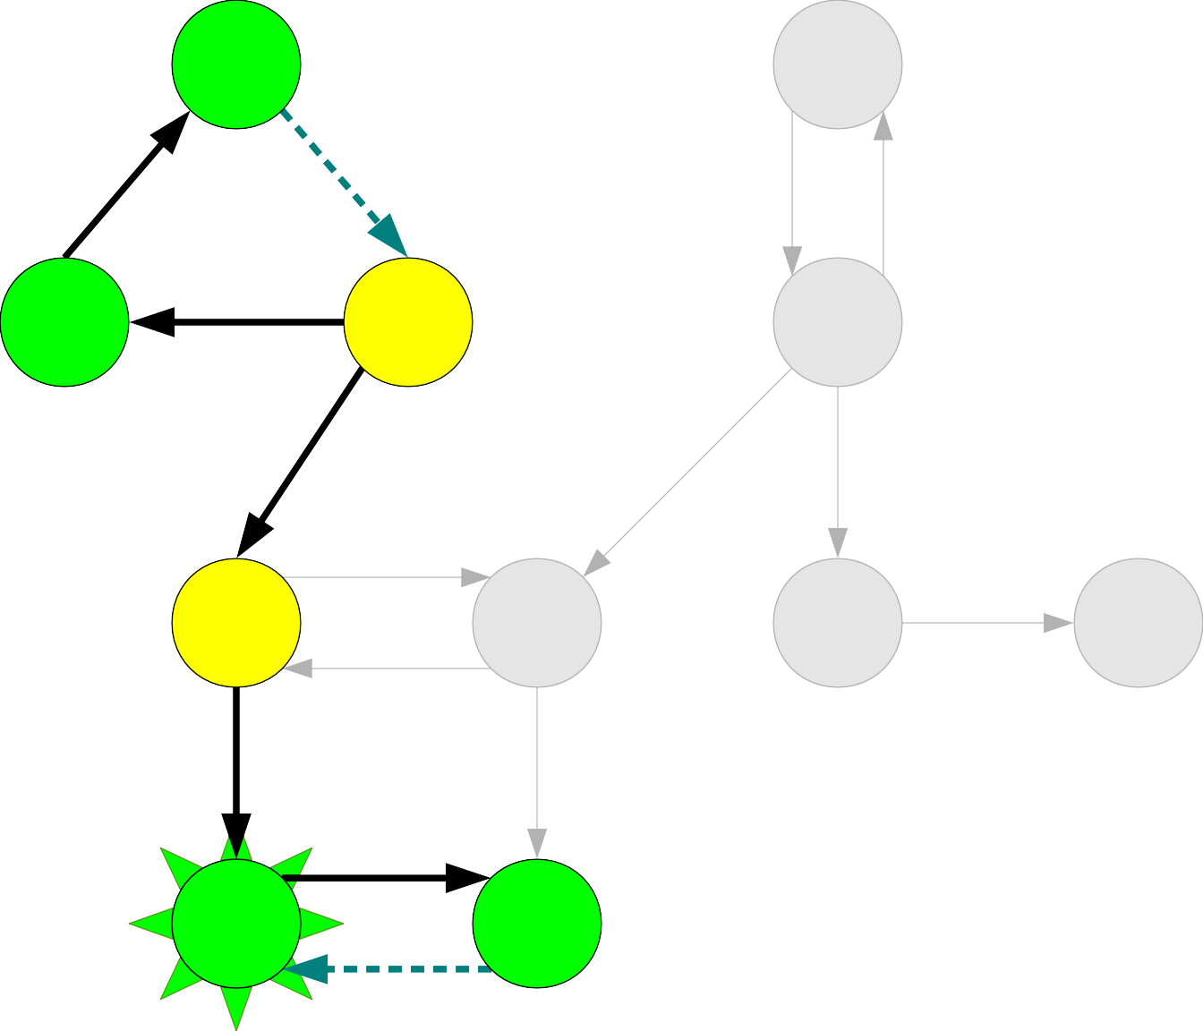
A |  |  | B
C | D |  | E
F |  | G | H I
J |  | K
A
C
K

Slide 174
A |  |  | B
C | D |  | E
F |  | G | H I
J |  | K
A
C
K
J

Slide 175
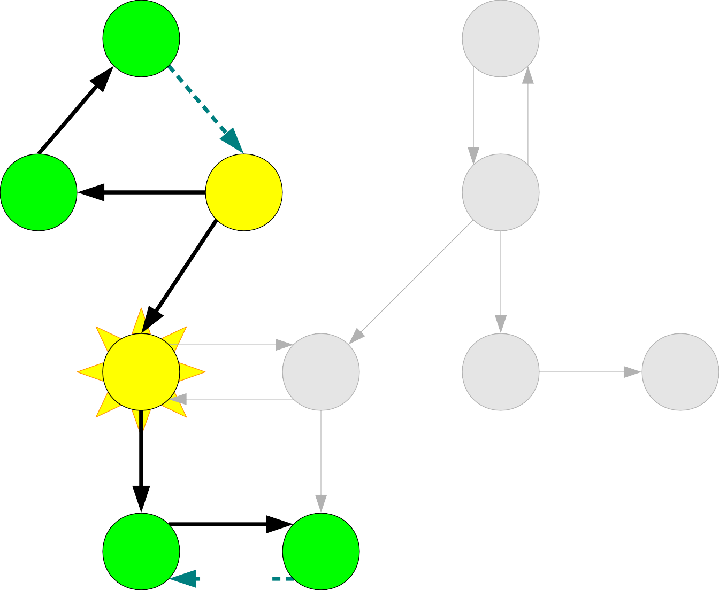
A |  |  | B
C | D |  | E
F |  | G | H I
J |  | K
A
C
K
J

Slide 176
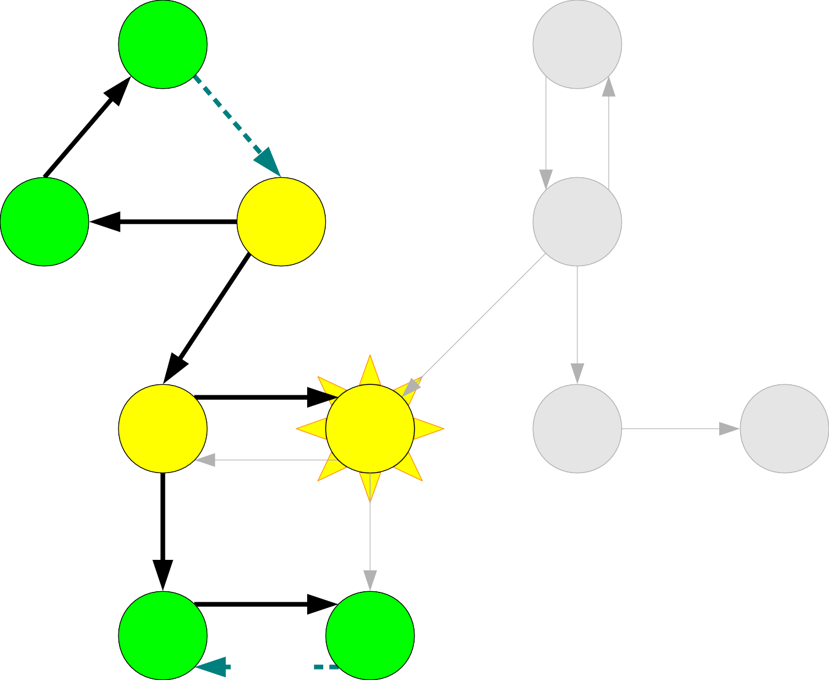
A |  |  | B
C | D |  | E
F |  | G | H I
J |  | K
A
C
K
J

Slide 177
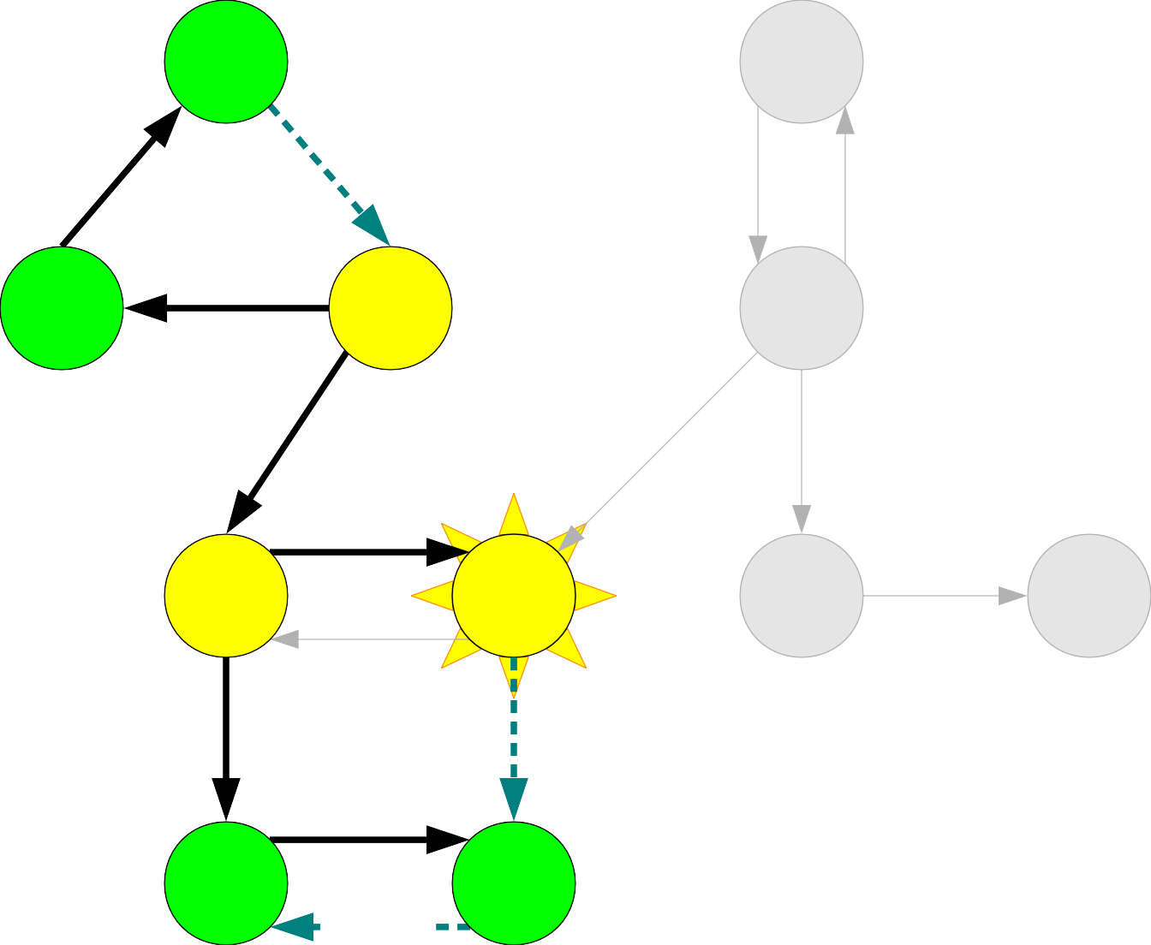
A |  |  | B
C | D |  | E
F |  | G | H I
J |  | K
A
C
K
J

Slide 178

A |  |  | B
C | D |  | E
F |  | G | H I
J |  | K
A
C
K
J

Slide 179
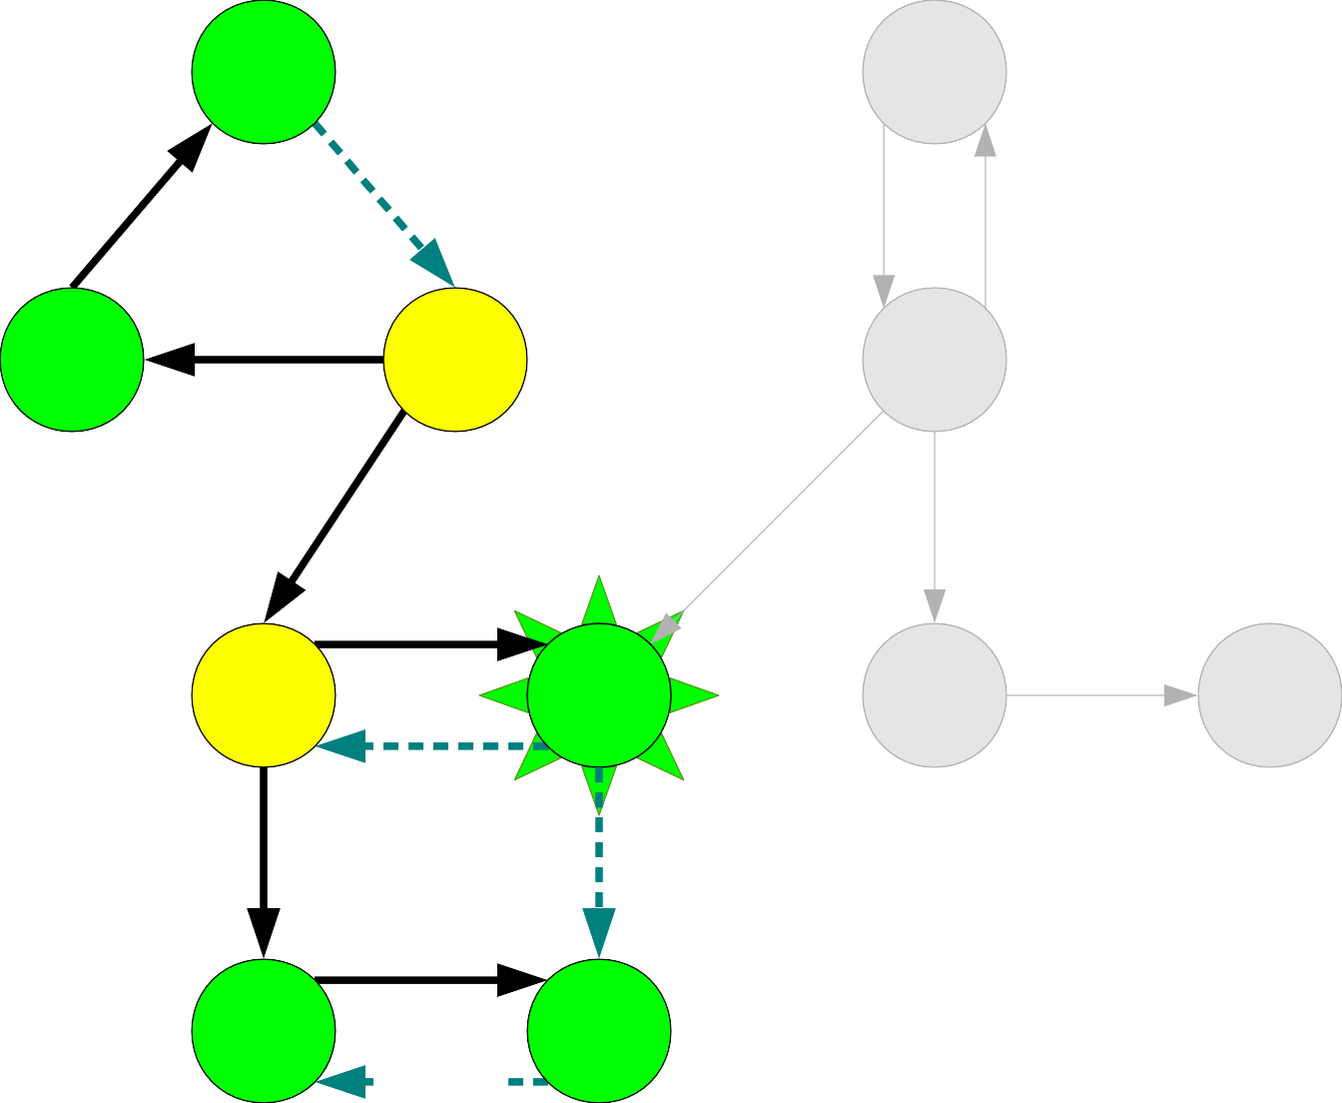
A |  |  | B
C | D |  | E
F |  | G | H I
J |  | K
A
C
K
J

Slide 180
A |  |  | B
C | D |  | E
F |  | G | H I
J |  | K
A
C
K
J
G

Slide 181
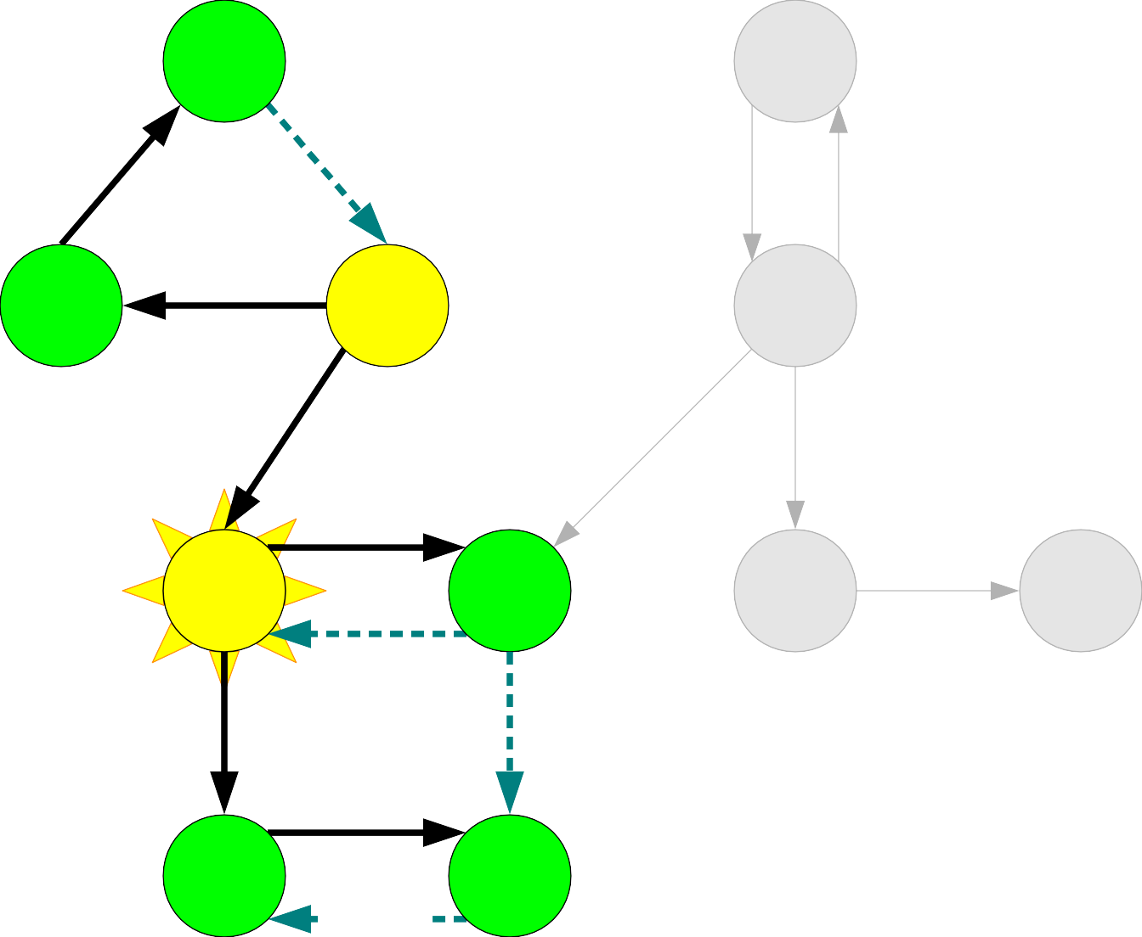
A |  |  | B
C | D |  | E
F |  | G | H I
J |  | K
A
C
K
J
G

Slide 182
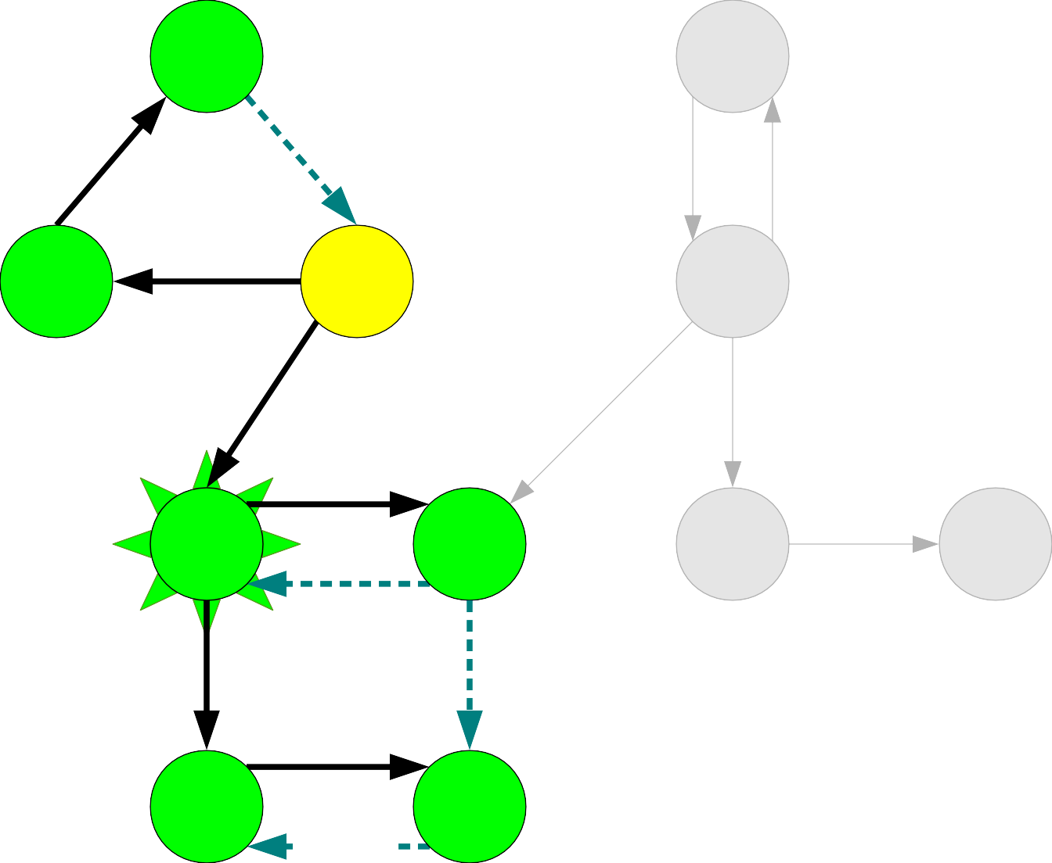
A |  |  | B
C | D |  | E
F |  | G | H I
J |  | K
A
C
K
J
G

Slide 183
A |  |  | B
C | D |  | E
F |  | G | H I
J |  | K
A
C
K
J
G
F

Slide 184
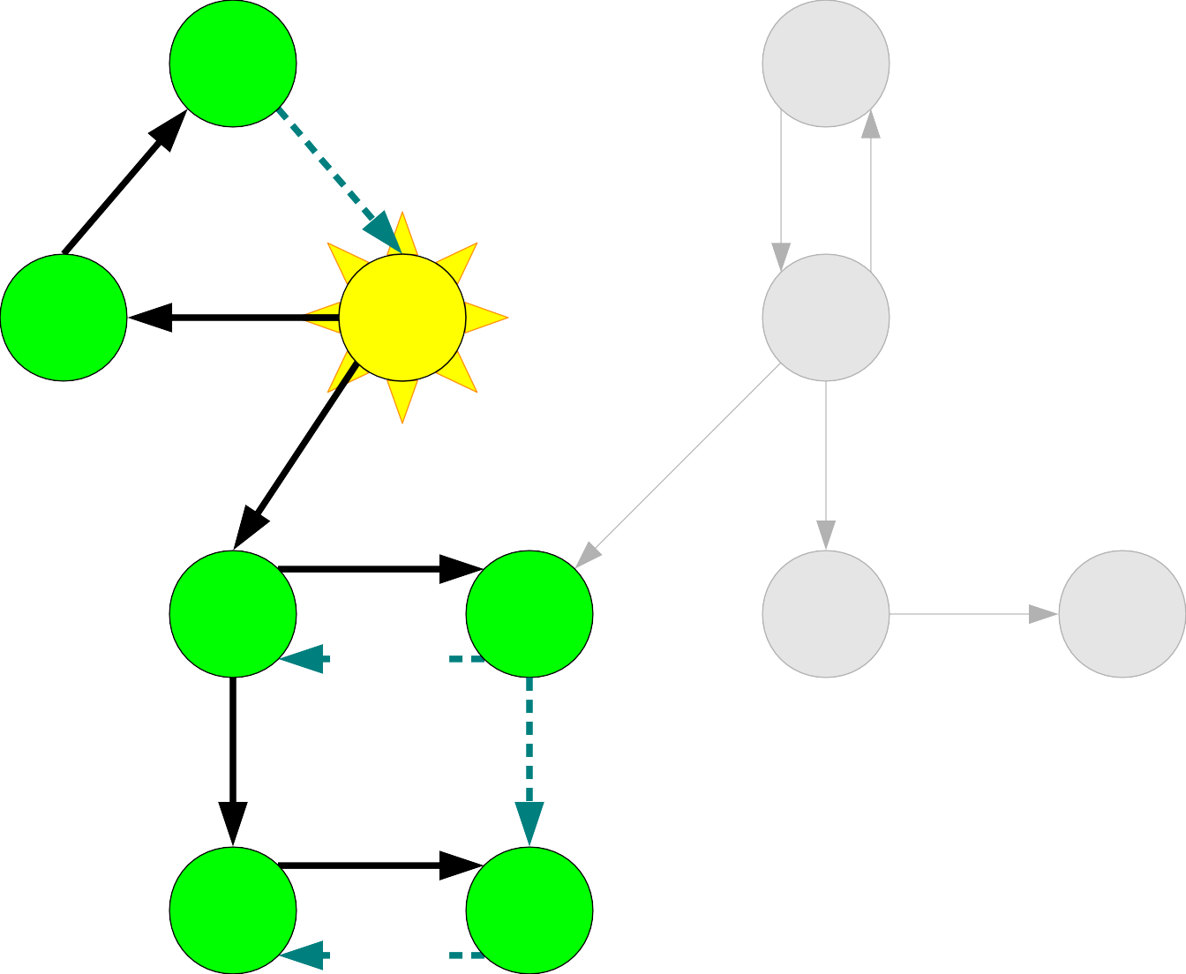
A |  |  | B
C | D |  | E
F |  | G | H I
J |  | K
A
C
K
J
G
F

Slide 185
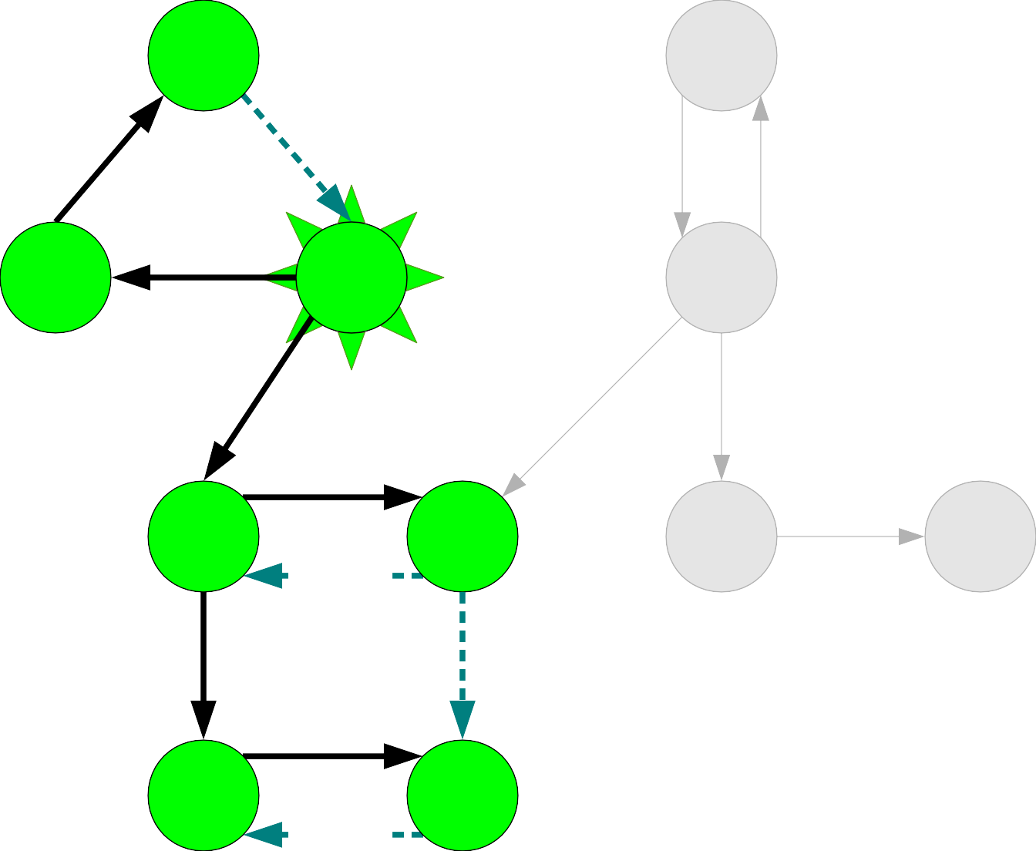
A |  |  | B
C | D |  | E
F |  | G | H I
J |  | K
A
C
K
J
G
F

Slide 186
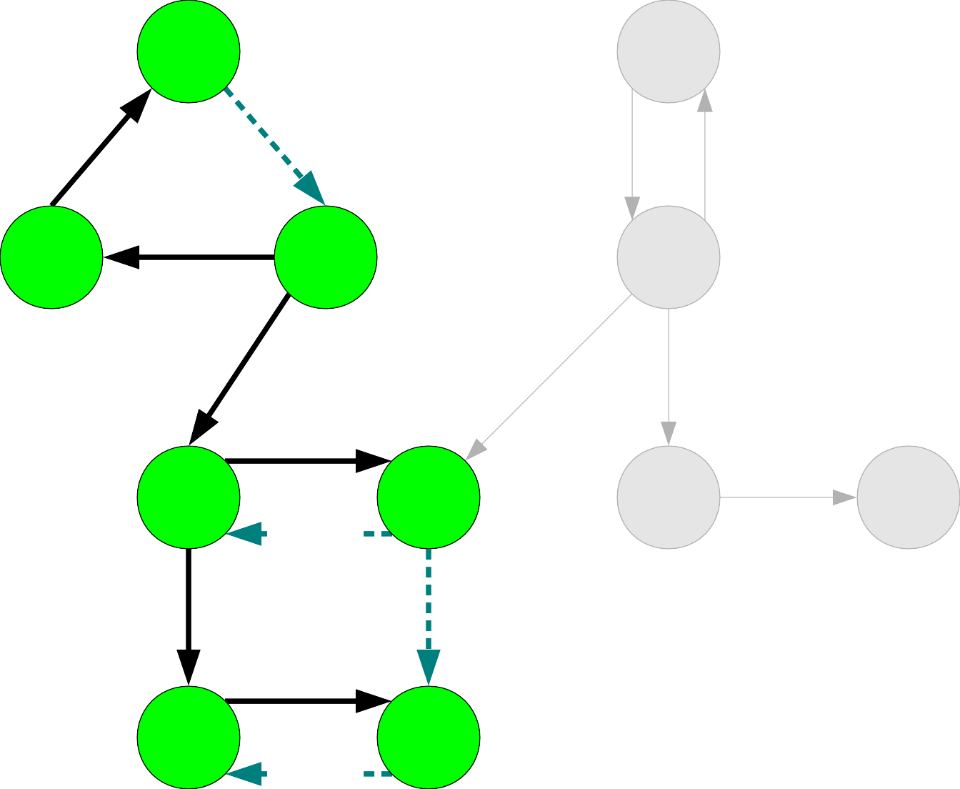
A |  |  | B
C | D |  | E
F |  | G | H I
J |  | K
A
C
K
J
G
F
D

Slide 187
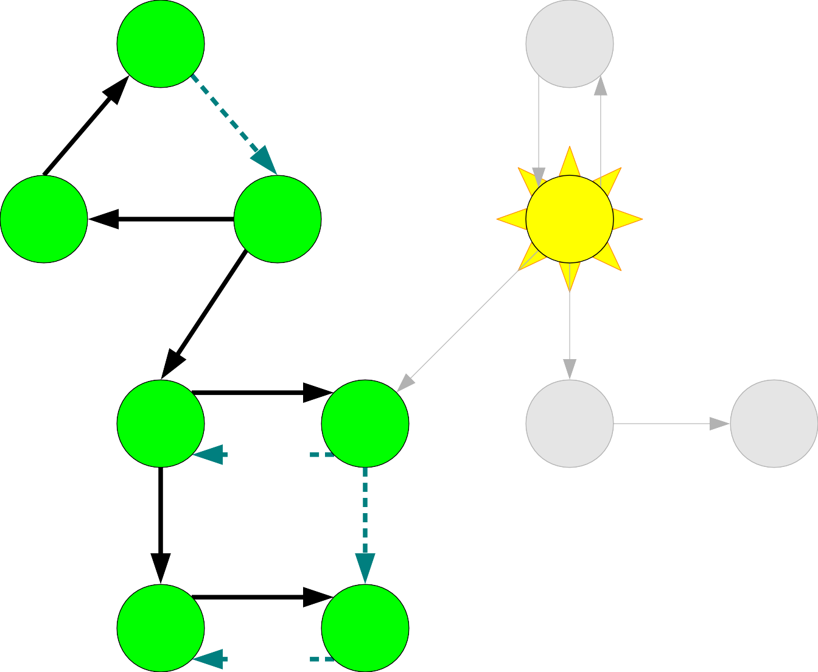
A |  |  | B
C | D |  | E
F |  | G | H I
J |  | K
A
C
K
J
G
F
D

Slide 188
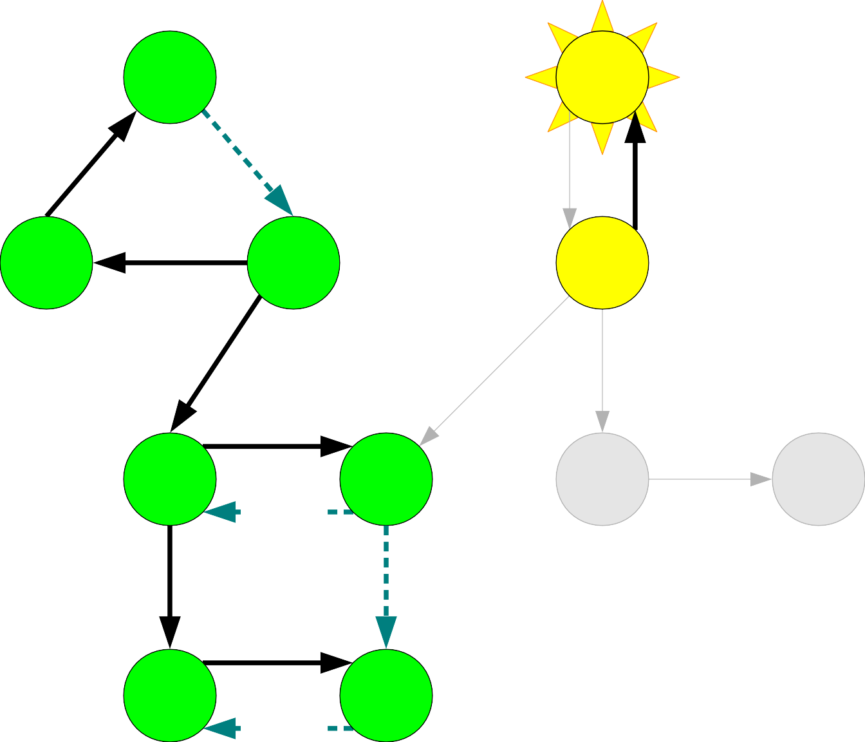
A |  |  | B
C | D |  | E
F |  | G | H I
J |  | K
A
C
K
J
G
F
D

Slide 189

A |  |  | B
C | D |  | E
F |  | G | H I
J |  | K
A
C
K
J
G
F
D

Slide 190
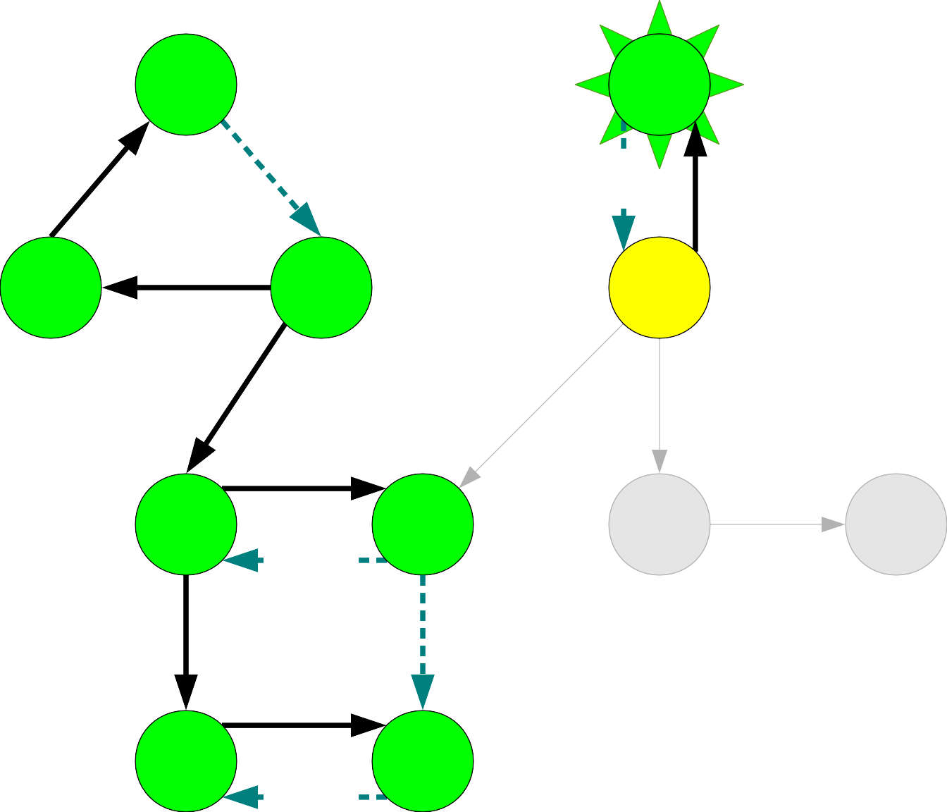
A |  |  | B
C | D |  | E
F |  | G | H I
J |  | K
A
C
K
J
G
F
D

Slide 191

A |  |  | B
C | D |  | E
F |  | G | H I
J |  | K
A
C
K
J
G
F
D
B

Slide 192
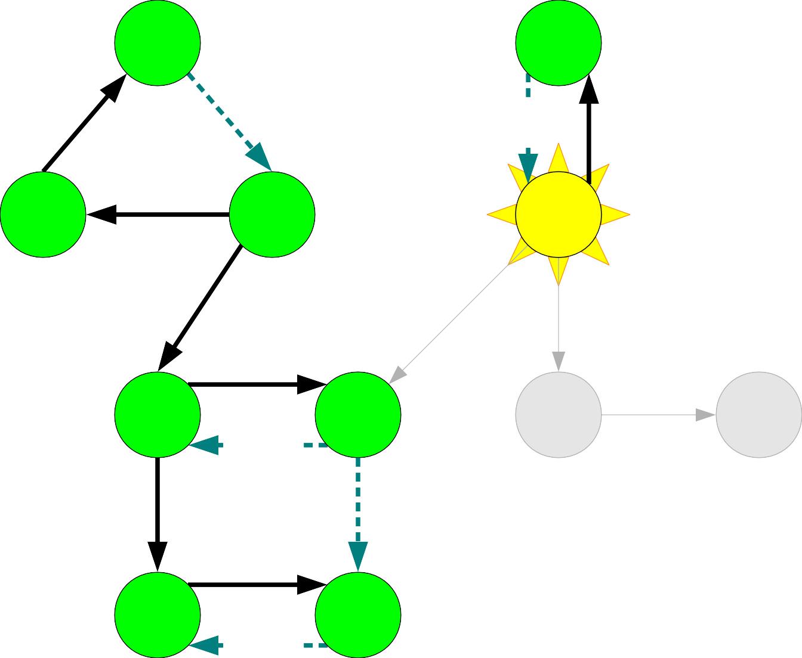
A |  |  | B
C | D |  | E
F |  | G | H I
J |  | K
A
C
K
J
G
F
D
B

Slide 193
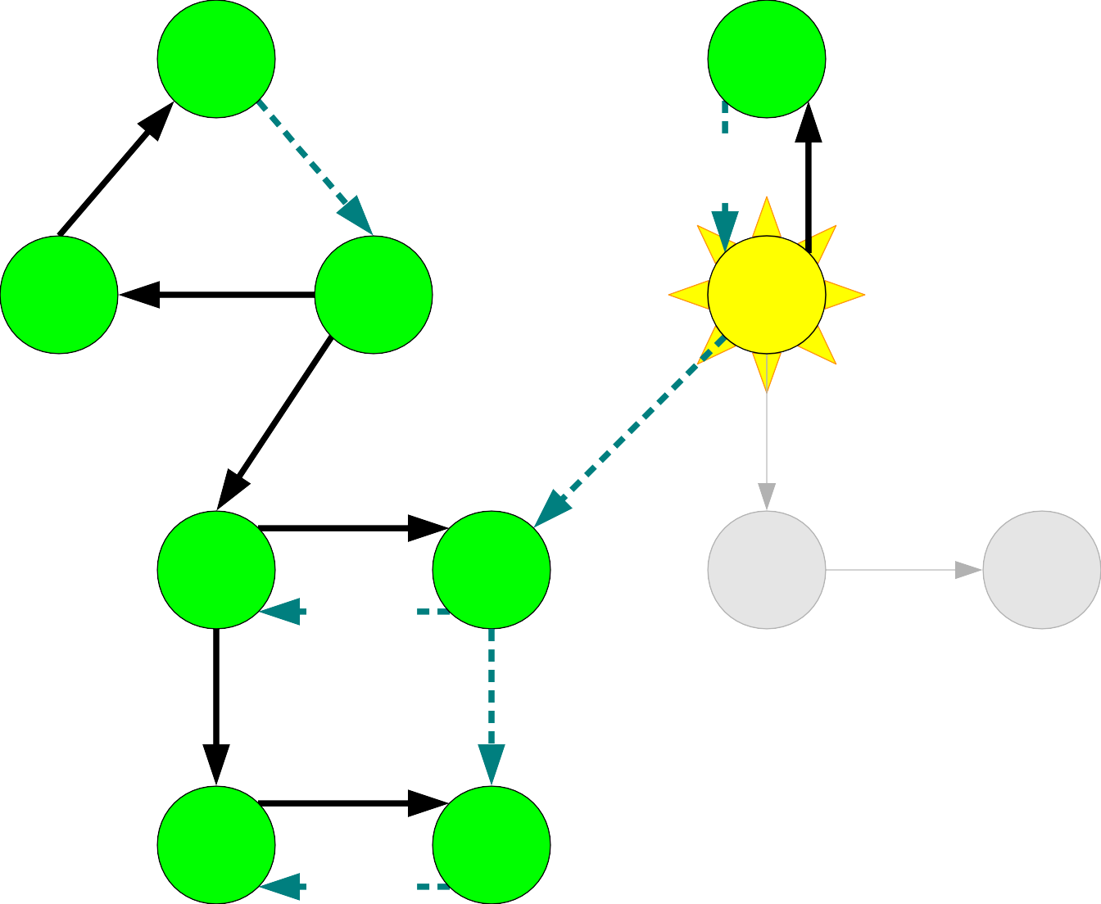
A |  |  | B
C | D |  | E
F |  | G | H I
J |  | K
A
C
K
J
G
F
D
B

Slide 194
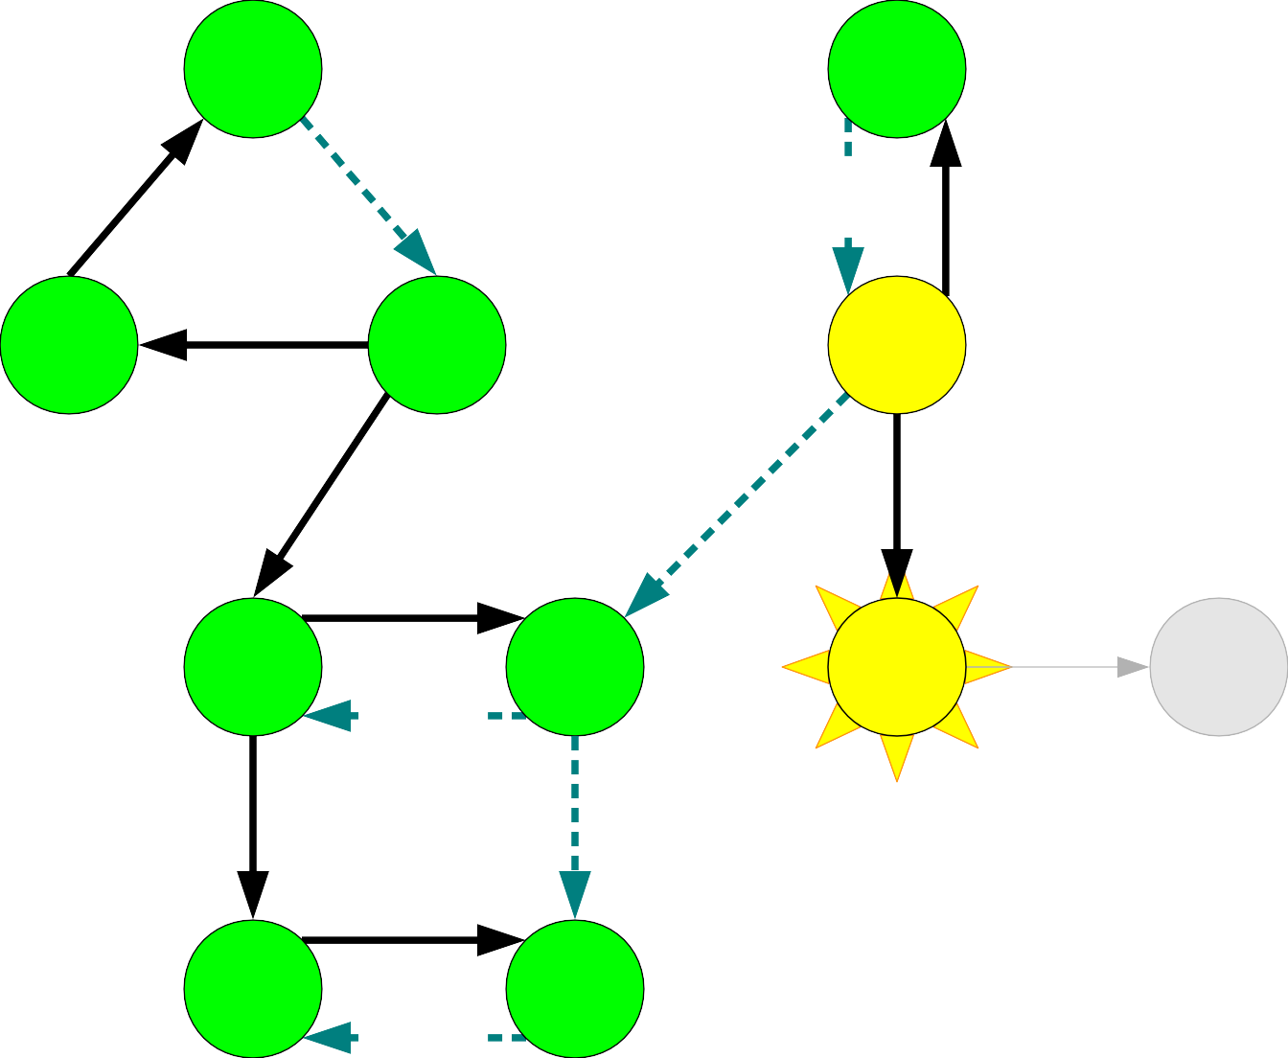
A |  |  | B
C | D |  | E
F |  | G | H I
J |  | K
A
C
K
J
G
F
D
B

Slide 195
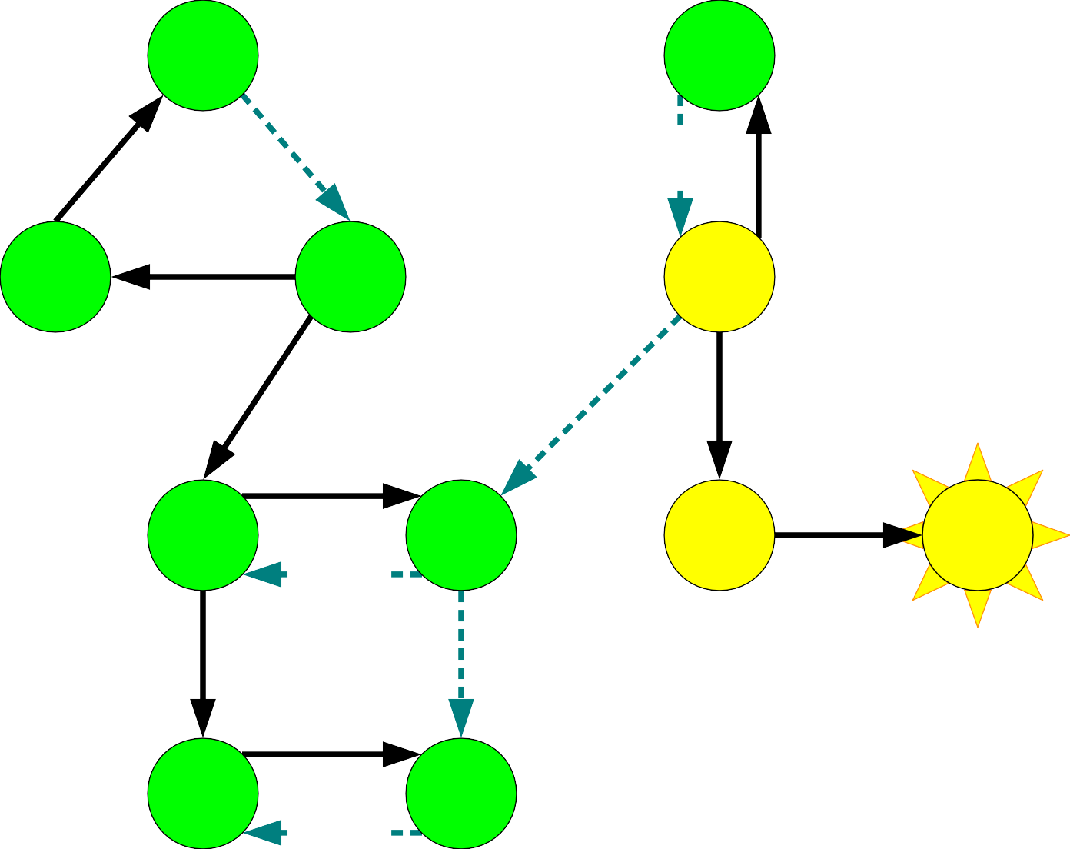
A |  |  | B
C | D |  | E
F |  | G | H I
J |  | K
A
C
K
J
G
F
D
B

Slide 196
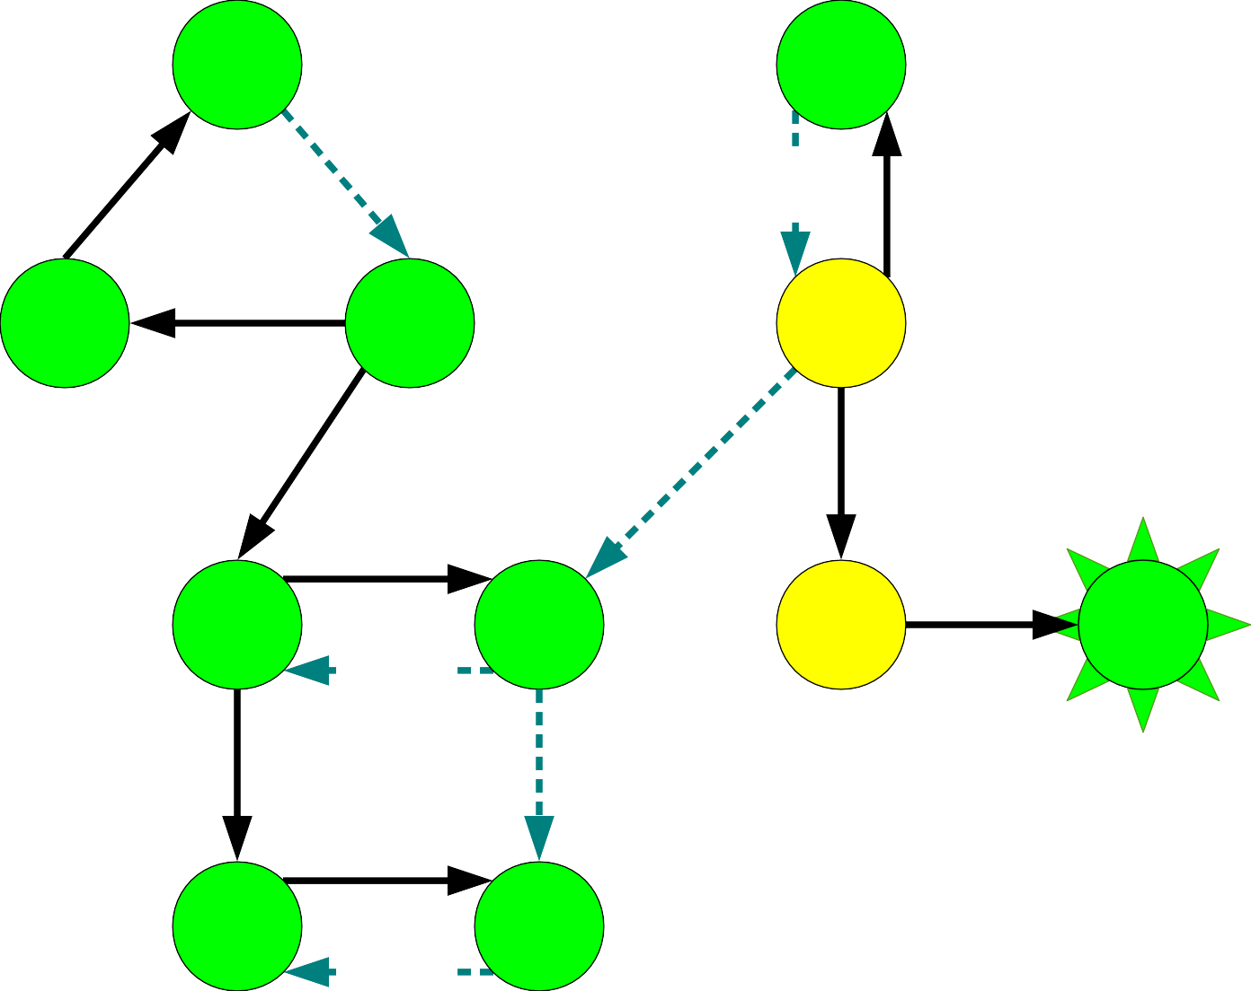
A |  |  | B
C | D |  | E
F |  | G | H I
J |  | K
A
C
K
J
G
F
D
B

Slide 197

A |  |  | B
C | D |  | E
F |  | G | H I
J |  | K
A
C
K
J
G
F
D
B
I

Slide 198
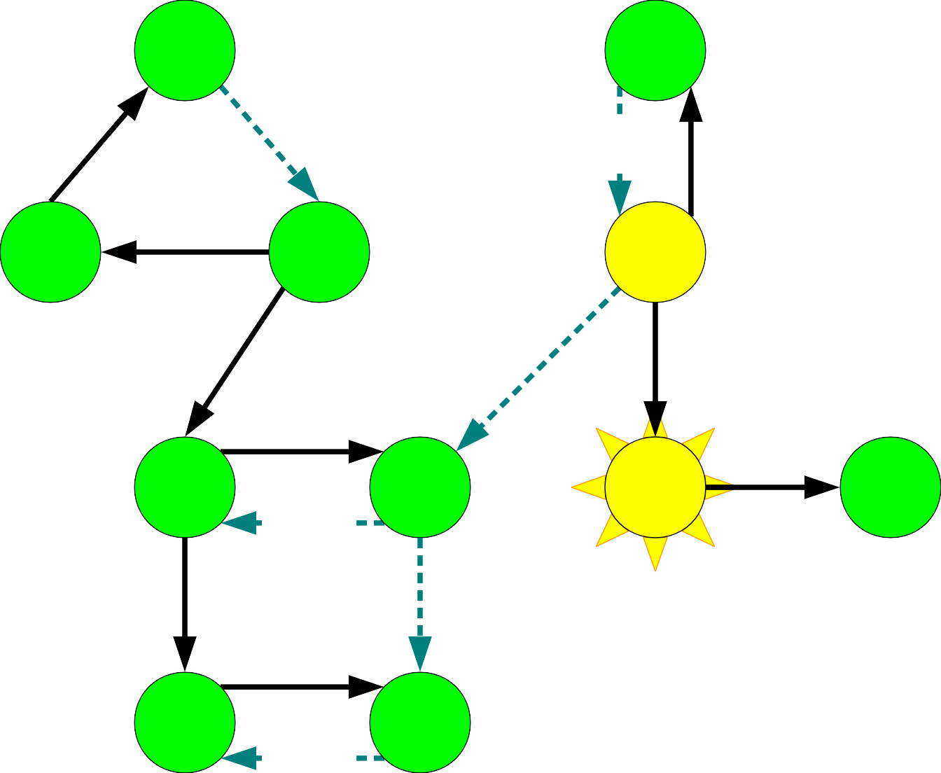
A |  |  | B
C | D |  | E
F |  | G | H I
J |  | K
A
C
K
J
G
F
D
B
I

Slide 199
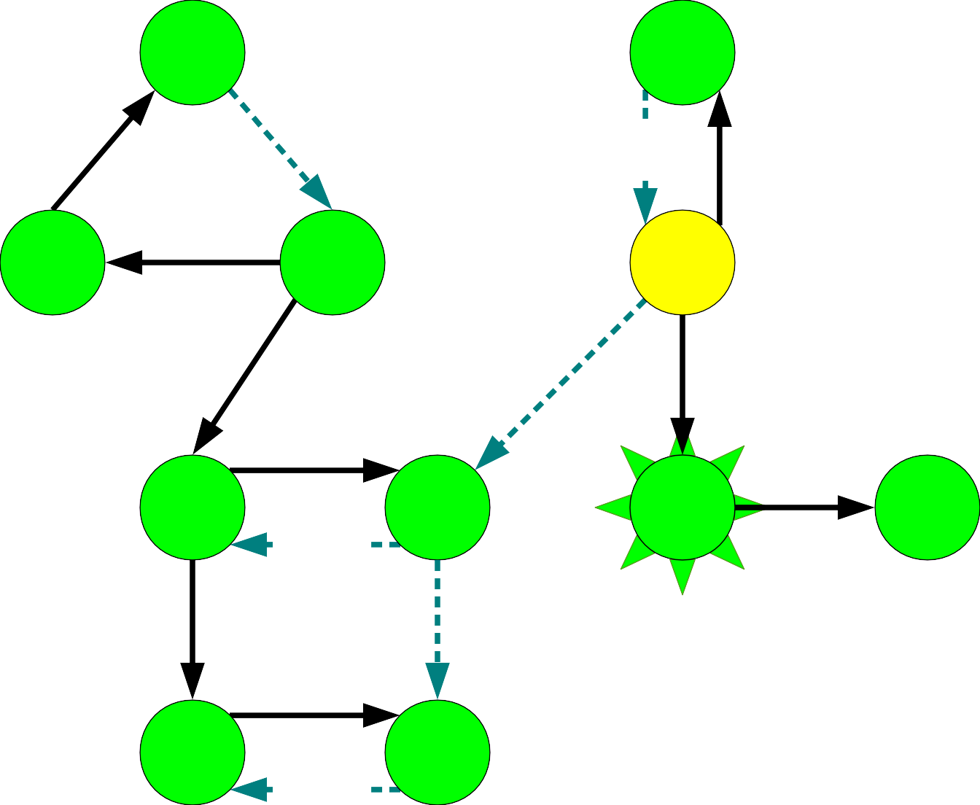
A |  |  | B
C | D |  | E
F |  | G | H I
J |  | K
A
C
K
J
G
F
D
B
I

Slide 200

A |  |  | B
C | D |  | E
F |  | G | H I
J |  | K
A
C
K
J
G
F
D
B
I
H

Slide 201

A |  |  | B
C | D |  | E
F |  | G | H I
J |  | K
A
C
K
J
G
F
D
B
I
H

Slide 202

A |  |  | B
C | D |  | E
F |  | G | H I
J |  | K
A
C
K
J
G
F
D
B
I
H

Slide 203
A |  |  | B
C | D |  | E
F |  | G | H I
J |  | K
A
C
K
J
G
F
D
B
I
H
E

Slide 204

A |  |  | B
C | D |  | E
F |  | G | H I
J |  | K
A
C
K
J
G
F
D
B
I
H
E

Slide 205

A |  |  | B
C | D |  | E
F |  | G | H I
J |  | K
A
C
K
J
G
F
D
B
I
H
E

Slide 206

A |  |  | B
C | D |  | E
F |  | G | H I
J |  | K
A
C
K
J
G
F
D
B
I
H
E

Slide 207
A |  |  | B
C | D |  | E
F |  | G | H I
J |  | K
A
C
K
J
G
F
D
B
I
H
E

Slide 208
A |  |  | B
C | D |  | E
F |  | G | H I
J |  | K
A
C
K
J
G
F
D
B
I
H
E

Slide 209
A |  |  | B
C | D |  | E
F |  | G | H I
J |  | K
A
C
K
J
G
F
D
B
I
H
E

Slide 210

A
B
C
D
E
F
G
H
I
J
K
A C K J G F D B I H E E H I D F J

Slide 211
A |  |  | B
C | D |  | E
F |  | G | H I
J |  | K
A
C
K
J
G
F
D
B
I
H
E

Slide 212
A |  |  | B
C | D |  | E
F |  | G | H I
J |  | K
A
C
K
J
G
F
D
B
I
H
E

Slide 213

A |  |  | B
C | D |  | E
F |  | G | H I
J |  | K
A
C
K
J
G
F
D
B
I
H
E

Slide 214

A
C
D
F
G
H
I
J
K
A
C
K
J
G
F
D
B
I
H
E

Slide 215

A
C
D
F
G
H
I
J
K
A
C
K
J
G
F
D
B
I
H
E

Slide 216
A
C F | D | G
J |  | K
I
A
C
K
J
G
F
D
B
I
H
E

Slide 217

A
C F | D | G
J |  | K
I
A
C
K
J
G
F
D
B
I
H
E

Slide 218
A
C F | D | G
J |  | K
A
C
K
J
G
F
D
B
I
H
E

Slide 219

A
C F | D | G
J |  | K
A
C
K
J
G
F
D
B
I
H
E

Slide 220
F G
J K
A
C
K
J
G
F
D
B
I
H
E

Slide 221

F G
J K
A
C
K
J
G
F
D
B
I
H
E

Slide 222
J K
A
C
K
J
G
F
D
B
I
H
E

Slide 223
J K
A
C
K
J
G
F
D
B
I
H
E

Slide 224
A
C
K
J
G
F
D
B
I
H
E

Slide 225
Making Progress!
●
The last node colored green by DFS must be the last node colored green in some SCC.
This gives a rough idea for an algorithm:
●
●
Take the last node in the ordering that hasn't already been put into an SCC.
Find all nodes in the same SCC as that node. Repeat.
●
●

Slide 226
Making Progress!
The last node colored green by DFS must be the last node colored green in some SCC.
This gives a rough idea for an algorithm:
Take the last node in the ordering that hasn't already been put into an SCC.
Find all nodes in the same SCC as that node. Repeat.
●

Slide 227

A |  |  | B
C | D |  | E
F |  | G | H I
J |  | K
A
C
K
J
G
F
D
B
I
H
E

Slide 228
A |  |  | B
C | D |  | E
F |  | G | H I
J |  | K
A
C
K
J
G
F
D
B
I
H
E

Slide 229
A
B
A
C
D
E
C
D
F
G
H I
Claim 1: This node must belong to a source SCC.
J
K
A
C
K
J
G
F
D
B
I
H
E

Slide 230
A |  |  | B
C | D |  | E
F |  | G | H I
J |  | K
A
C
K
J
G
F
D
B
I
H
E

Slide 231
Transpose the Graph

Slide 232

A |  |  | B
C | D |  | E
F |  | G | H I
J |  | K
A
C
K
J
G
F
D
B
I
H
E

Slide 233
A
B
A
C
D
E
C
D
F
G
H I
Claim 2: The SCCs of this reversed graph are the same as the SCCs of the original graph.
J
K
A
C
K
J
G
F
D
B
I
H
E

Slide 234
A
B
A
C
D
E
C
D
F
G
H I
Claim 3: Since E is in a source SCC in the original graph, E is in a sink SCC in this graph.
J
K
A
C
K
J
G
F
D
B
I
H
E

Slide 235
A
B
A
C
D
E
C
D
F
G
H I
Claim 4: The only nodes reachable from E are the nodes in the same SCC as E.
J
K
A
C
K
J
G
F
D
B
I
H
E

Slide 236
A |  |  | B
C | D |  | E
F |  | G | H I
J |  | K
A
C
K
J
G
F
D
B
I
H
E

Slide 237

A |  |  | B
C | D |  | E
F |  | G | H I
J |  | K
A
C
K
J
G
F
D
B
I
H
E

Slide 238

A |  |  | B
C | D |  | E
F |  | G | H I
J |  | K
A
C
K
J
G
F
D
B
I
H
E

Slide 239
A |  |  | B
C | D |  | E
F |  | G | H I
J |  | K
A
C
K
J
G
F
D
B
I
H
E

Slide 240
A
B
C
D
E
F
G
H I
Claim 5: The only unvisited nodes reachable from H are the nodes in the same SCC as H.
J
K
A
C
K
J
G
F
D
B
I
H
E

Slide 241


A |  |  | B
C | D |  | E
F |  | G | H I
J |  | K
A
C
K
J
G
F
D
B
I
H
E

Slide 242

A |  |  | B
C | D |  | E
F |  | G | H I
J |  | K
A
C
K
J
G
F
D
B
I
H
E

Slide 243


A |  |  | B
C | D |  | E
F |  | G | H I
J |  | K
A
C
K
J
G
F
D
B
I
H
E

Slide 244

A |  |  | B
C | D |  | E
F |  | G | H I
J |  | K
A
C
K
J
G
F
D
B
I
H
E

Slide 245

A |  |  | B
C | D |  | E
F |  | G | H I
J |  | K
A
C
K
J
G
F
D
B
I
H
E

Slide 246


A |  |  | B
C | D |  | E
F |  | G | H I
J |  | K
A
C
K
J
G
F
D
B
I
H
E

Slide 247

A |  |  | B
C | D |  | E
F |  | G | H I
J |  | K
A
C
K
J
G
F
D
B
I
H
E

Slide 248


A |  |  | B
C | D |  | E
F |  | G | H I
J |  | K
A
C
K
J
G
F
D
B
I
H
E

Slide 249

A |  |  | B
C | D |  | E
F |  | G | H I
J |  | K
A
C
K
J
G
F
D
B
I
H
E

Slide 250

A |  |  | B
C | D |  | E
F |  | G | H I
J |  | K
A
C
K
J
G
F
D
B
I
H
E

Slide 251


A |  |  | B
C | D |  | E
F |  | G | H I
J |  | K
A
C
K
J
G
F
D
B
I
H
E

Slide 252

A |  |  | B
C | D |  | E
F |  | G | H I
J |  | K
A
C
K
J
G
F
D
B
I
H
E

Slide 253

A |  |  | B
C | D |  | E
F |  | G | H I
J |  | K
A
C
K
J
G
F
D
B
I
H
E

Slide 254

A |  |  | B
C | D |  | E
F |  | G | H I
J |  | K
A
C
K
J
G
F
D
B
I
H
E

Slide 255
A |  |  | B
C | D |  | E
F |  | G | H I
J |  | K
A
C
K
J
G
F
D
B
I
H
E

Slide 256
procedure kosarajuSCC(graph G):
for each node v in G: color v gray.
let L be an empty list.
for each node v in G: if v is gray:
run DFS starting at v, appending each node to list L when it is colored green.
construct G^{R} from G.
For each node v in G^{R}: color v gray.
let scc be a new array of length n
let index = 0
for each node v in L, in reverse order:
if v is gray:
run DFS on v in G^{R}, setting scc[u] = index for each node u colored green this way.
index = index + 1
return scc

Slide 257
Proving Correctness
Here's a quick sketch of the correctness proof of Kosaraju's algorithm:
As proven earlier, the last nodes in each SCC will be returned in reverse topological order.
Each time we do a DFS in the reverse graph starting from some node, we only reach nodes in the same SCC or in ancestor SCCs.
Since we process the SCCs in topological order, at each point the only unvisited nodes reachable are nodes in the same SCC.

Slide 258
Kosaraju's Algorithm Runtime
What is the runtime of the Kosaraju's algorithm?
Runtime for running DFS starting from each node in the graph: Θ(m + n).
Runtime for reversing the graph and coloring all nodes gray: Θ(m + n).
Runtime for running DFS in the reversed graph: Θ(m + n).
Total runtime: Θ(m + n).
This is a linear-time algorithm!

Slide 259
Why all this matters
Depth-first search is an important building block for many other algorithms, including topological sorting, finding connected components, and Kosaraju's algorithm.
We can find CCs and SCCs in (asymptotically) the same amount of time.
Further reading: look up Tarjan's SCC algorithm for a way to find SCCs with a single DFS!

